Slide 1
Unidad II Creación de componentes y librerías dinámicas
2.1 Creación de componentes.
2.2 Creación de librerías dinámicas.

Slide 2
COM

Slide 3
What is COM?
Simply put, COM is a system API that allows your application to access the functions and data in another application (EXE) or a dynamically linked library (DLL).
COM actually stands for Component Object Model as an attempt to create an analogy with the hardware inside your computer.

Slide 4
Why Was COM Developed?
COM evolved out of the solution to a specific problem — how to allow a word processor to edit the spread sheet in a letter without the user having to exit the word processor to do it.
This solution was called OLE (Object Linking and Embedding) and contained a very sophisticated API that allows you even today to edit a letter within Internet Explorer using Microsoft Word.
Most of this functionality is found in the OLE32.DLL.

Slide 5
What are the Other Uses of COM?
Once the COM API was exposed, Microsoft used it to create what were then called OLE Controls to allow sophisticated controls (e.g., buttons that spiral, list boxes that play music) written in Visual C++ to be accessible to Visual Basic applications.
Eventually this same technology was used to allow a control to be downloaded and used by your web browser.
At this point, the name changed to ActiveX Controls or just plain ActiveX purely for marketing reasons.
Although you can package any functionality in an ActiveX Control (this is still the only way to create a COM object in VB), its requirements have been specialized for supporting a user interface control.

Slide 6
How Does COM Work?
1. First, you call the ::CoCreateInstance() COM API call, either directly or through a C++ class that wraps it. You specify two ID’s, one for the class you want to instantiate and one for the DLL or EXE file it lives in. Very unique ID’s are used instead of a class or filename to avoid the problem of having two COM objects with the same names on the same large system.
2. Since the DLL or EXE filename is specified with an ID, COM has to first convert it to an actual DLL or EXE filename by looking in the system registry where it was stored when the DLL/EXE was installed.
3. Now supplied with the actual filename, COM loads up the requested DLL using the LoadLibrary() API call or starts the desired EXE using the RPC (Remote Procedure Call) API.

Slide 7
How Does COM Work?
4. Then COM tells the DLL or EXE which class to instantiate by using the other ID you specified to ::CoCreateInstance(). Once the DLL or EXE has created an object, ::CoCreateInstance() returns its pointer.
5. If the class lives in a DLL on your own system, calling its methods and passing arguments to it is not unlike any DLL method call using a class pointer, i.e., p->Func(a,b);.
6. If however you’re calling a method on an object that was created in an EXE or on another machine, the arguments you pass to it go through the same serialization process that you would expect between any client and its server over a network — except COM does this for you automatically and almost transparently.
7. Destroying a COM object is a matter of telling the COM API you no longer need it by decrementing a reference count in the object. Once it reaches zero, COM destroys the object.
8. If all of the objects a DLL has supplied to your application are destroyed, COM unloads the DLL. If all of the objects an EXE has supplied any application on your system or the network are destroyed, COM stops the EXE

Slide 8
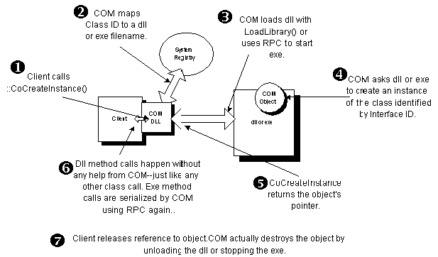
How Does COM Work?

Slide 9
Guids
A GUID is the Microsoft interpretation of the Universally Unique Identifier (UUID) proposed by the Open Software Foundation (OSF).
A guid is a 128 bit number that is theoretically unique over time and space.
To make it unique over space, it includes a fixed number that identifies the machine it was created on, usually a network card address.
If there is no network card, another equally unique but constant number is located.
To make a guid unique over time, it includes a time stamp of when it was created.
This stamp is the number of minutes that have elapsed since 1490.
And just to be on the safe side, a guid also contains a random number generated just for the occasion.

Slide 10
System Registry
COM information can be found in the system registry under the HKEY_CLASSES_ROOT key which itself points to the information under the HKEY_LOCAL_MACHINE\SOFTWARE\Classes\ key. The majority of the listing you’ll find directly under this key are file extension associations (e.g., .txt is associated with notepad.exe) and COM Program ID’s, but buried in this listing, you’ll also find three other COM subkeys: AppID, CLSID, and Interface.

Slide 11
UserControls (Advanced C# Programming)
The UserControl class is a control that contains a drawing surface, like a form, that allows you to design composite controls in the Forms Designer for Windows Forms and ASP.NET.
When designing UserControls, you perform the same activities that you would perform when designing a form. Drag and drop controls onto the form, generate the event handlers, modify properties, and implement new methods.
The only noteworthy difference between designing forms and UserControls is that forms are generally designed for end users and UserControls are designed for both end users and other developers—that is, your UserControls will appear on forms and in the Toolbox.
The last bit of information suggests that if we want to build reusable UserControls then we need to make them general enough so they are not too dependent on a specific application.

Slide 12
Understanding UserControls
There are three basic strategies for implementing custom controls in C#.
You can inherit from the Control class to have the ultimate flexibility but the most amount of work.
You can implement from a control that is closer to the new one that you want to make, resulting in less flexibility and less work. For instance, if you want to make a label control that has special effects, you could inherit from System.Windows.Forms.Label.
Finally, if you want to make a control that is composed of several visual elements, then the best way to do it is to create a UserControl.

Slide 13
What Is a UserControl?
UserControls are defined in the System.Windows.Forms and System.Web.UI namespaces.
For our purposes, we are referring to the System.Windows.Forms.UserControl.
UserControls inherit from ContainerControl, which in turn inherits from ScrollableControl, which itself inherits from the Control Class.
If you look at the .NET Framework, you will note that this is exactly the same ancestry as a Windows Form.

Slide 14
What Is a UserControl?
When you are designing a UserControl you will perform the same activities that you perform when designing a Form.
Like Forms, UserControls contain other controls referred to as constituent controls.
A UserControl has a graphical user interface, as do Forms, and usually contains many constituent controls to make up part of a whole solution.

Slide 15
GUI
There are several strategies that you can employ when designing the visual aspect of UserControls:
You can get great background graphics and make your controls semi-transparent.
You can get a right-brained person or graphic artist to design some basic visuals for you, and then you can create a standard set of UserControls that you can use over and over again.
You can layer controls to create the effect of both depth and richness, mirroring some of the better-looking software that exists.

Slide 16
Creating a Control Library
The Windows Control Library template in the New Project dialog is a good way to begin building UserControls. The Windows Control Library will yield an assembly with a DLL extension, and the project will be created with a single UserControl.
When you create a Windows Control Library, the output type will be Class Library (read DLL), and the template will add the System, System.Data, System.Drawing, System.Windows.Forms, and System.XML namespace references.
The template will also add AssemblyInfo.cs and UserControl1.cs modules.
The AssemblyInfo file is provided for adding metadata, and the UserControl module contains a class, which inherits from UserControl, that you can use to begin implementing your first UserControl.

Slide 17
Creating a Control Library
A recommended approach to building UserControls at this point is to build the control with a general solution in mind and to use a generic application to test the UserControl.
When the control has the general properties, methods, events, and constituent controls that you have determined are needed, you can incorporate the new UserControl into your application.

Slide 18
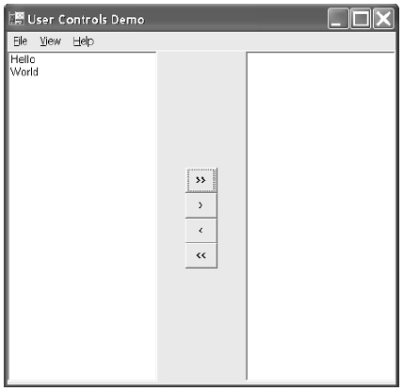
Creating a ButtonCluster Control
The ButtonCluster uses four standard Button controls on a UserControl container.
The ButtonCluster control is shown at the center of the form in Figure.
The text on the buttons suggests that clicking a particular button will move the elements in the direction indicated by the arrow.

Slide 19
Creating a ButtonCluster Control
From Figure we can determine that the UserControl is composed of four buttons.
To keep the buttons aligned, we will need to respond to Resize events sent to the UserControl, we will need to modify the Text property for the buttons, and we will need to surface the individual Button Click events in order to allow users to respond to Click events.

Slide 20
Designing the UserControl Visual Interface
The visual appearance of our first user control is composed of four equally-sized buttons lined up in a vertical stack.
To make the control as generic as possible, we might want to allow the buttons to be aligned horizontally.
We may also want to allow the actual buttons to be rendered using other kinds of buttons
To create the button cluster class, create a new Windows Control Library project. Drop four buttons on the UserControl container.

Slide 21
Designing the UserControl Visual Interface
Use the Visual Studio .NET Format | Make Same Size | Both menu to make the buttons the exact same size. (Make the buttons roughly square.)
Use the Format | Align | Centers menu item to align the buttons along a center vertical axis.
Resize the UserControl to approximately the same width as a single button and the height to that of all four buttons (an example can be seen in Figure.
Don’t worry about precise visual sizing, as we will write the code to make the control visually perfect.
The next thing we need to do is write the code to resize each of the buttons proportionately to the size of the containing control.

Slide 22
Implementing the UserControl Resize Event Handler
When the UserControl is resized, we want our buttons to occupy and fully consume exactly one-fourth of the available space. Fortunately, the UserControl can be designed like a form.
To generate the Resize event handler, we can use the Event view of the Properties window.
private void UserControlButtons_Resize(object sender,
System.EventArgs e)
{
ResizeButtons();
}

Slide 23
Implementing the UserControl Resize Event Handler
Following a good convention, we simply implement the event handler by calling a wellnamed method.
The well-named method mitigates the need for a comment, and the name indicates precisely what the code will do.
As an alternative, we can override the OnResize method.
If you choose to override OnResize, make sure you call the base class method.
By convention, .NET uses the On prefix for event methods; hence, the Resize event would have an OnResize method that invokes it.
If you elect to override the OnResize method, then the overridden method might be implemented as follows:
protected override void OnResize(System.EventArgs e)
{
base.OnResize(e);
ResizeButtons();
}

Slide 24
Determining Equal Subdivisions for the Buttons
Now that we have an event handler, our UserControl is notified when it is resized. From this point, we can implement the code that sizes each button equally.
When we are coding, it is useful to determine when a solution is generic enough to make sense in some other context.
Determining the fractional part of a rectangle is generally useful, and experience suggests that I can reuse this behavior.
When code may be generally useful, it is a good idea to create a new class and implement the behavior in the new class.
The listing implements a Rectangle class that can calculate a new top and new bottom for a rectangle that is a fractional subdivision of a bounding rectangle.

Slide 25
The Rectangles class
using System;
using System.Drawing;
namespace UserControlsExamples
{
public class Rectangles
{
private Rectangles(){}
public static Rectangle GetVerticalRectangle(
Rectangle rectangle, int index, int segments )
{
Rectangle r = rectangle;
r.Size = new Size( r.Width,
NewBottom(rectangle, index, segments));
r.Location = new Point(0,
NewTop(rectangle, index, segments));
return r;
}
public static int NewTop( Rectangle rectangle,
int index, int segments )
{
return (int)((float)index / segments *
rectangle.Height);
}
public static int NewBottom( Rectangle rectangle,
int index, int segments)
{
return rectangle.Height / segments;
}
}
}
The class is pretty straightforward: calculate a new top based on the number of subdivisions and the actual division you want, and calculate the bottom by making the height an equal subdivision.

Slide 26
The Program
Now that we have some general methods for determining rectangular subdivisions, we can resize the buttons in the cluster quite easily.
private void Initialize()
{
buttons = new Button[]{buttonAllRight, buttonRight,
buttonLeft, buttonAllLeft};
}
private void ResizeButtons()
{
if( buttons == null ) return;
for( int i=0; i<buttons.Length; i++)
{
buttons[i].Bounds = Rectangles.GetVerticalRectangle(
this.Bounds, i, buttons.Length);
}
}

Slide 27
The Program
The ButtonCluster class was implemented to store a reference to each button in an array (see the preceding listing).
Storing the buttons in an array field facilitates iterating over each button and invoking the Rectangles.
GetVerticalRectangle method on each rectangle.
The argument this. Bounds is the rectangle for the user control.
The index i is used as the rectangular subdivision, and the Length of the array indicates the number of subdivisions.
This approach actually makes the code quite extensible, since we are not relying on literal values to determine the index or number of buttons.

Slide 28
Surfacing Constituent Events
When it comes to the visual aspects of our button cluster, all we need to do is modify the Text property and we are finished.
For a more refined look, use the Button.Image property and provide a graphic arrow.
Programmatically, however, we are not quite finished.
The purpose of buttons is to respond to Click events.
As the event handler is implemented so far, consumers will not be able to get at the Click events for the buttons contained on this control.
This presents a slightly sticky problem.
A solution is that we must surface the events of the constituent controls.

Slide 29
Promoting Events in Constituent Controls
When you add controls to a UserControl, the new controls are added as fields in the UserControl.
The properties of the controls on the UserControl are encapsulated two layers deep.
Assume you have an instance of a UserControl, userControl1. Further assume that userControl1 contains a Button control.
To get at the Text property of the button, a consumer would have to write some code like userControl1.Button.Text. Counting the number of member-of operators, we know that the Text property is two layers deep.
As a result, the button’s Text property is not going to show up in the Properties window.

Slide 30
Promoting Events in Constituent Controls
Assuming that Button is public, a consumer could programmatically modify the properties of the Button contained in the UserControl.
However, if you want to modify those properties and events in the Properties window, then you will have to surface the properties and events of constituent controls.
We want to enable consumers to write code that responds to the individual button clicks, so we’ll need to surface the Button Click events.
To surface constituent control events, we need to write event handlers for the controls.
Then we need to implement new events in the UserControl.
When the constituent control events are raised, we pass the raised events up to the new UserControl events.

Slide 31
Promoting Events in Constituent Controls
26:
27: public event EventHandler AllRightClick;
28: public event EventHandler RightClick;
29: public event EventHandler AllLeftClick;
30: public event EventHandler LeftClick;
31:
32: private void OnAllRightClick(object sender, System.EventArgs e)
33: {
34: if(AllRightClick != null)
35: AllRightClick(sender, e);
36: }
37:
38: private void OnRightClick(object sender, System.EventArgs e)
39: {
40: If(RightClick != null)
41: RightClick(sender, e);
42: }
43:
44: private void OnAllLeftClick(object sender, System.EventArgs e)
45: {
46: if(AllLeftClick != null)
47: AllLeftClick(sender, e);
48: }
49:
50: private void OnLeftClick(object sender, System.EventArgs e)
51: {
52: If(LeftClick != null)
53: LeftClick(sender, e);
54: }
1: private void Initialize()
2: {
3: buttons = new Button[]{buttonAllRight, buttonRight,
4: buttonLeft, buttonAllLeft};
5:
6: buttonAllRight.Click += new EventHandler(OnAllRightClick);
7: buttonRight.Click += new EventHandler(OnRightClick);
8: buttonAllLeft.Click += new EventHandler(OnAllLeftClick);
9: buttonLeft.Click += new EventHandler(OnLeftClick);
10: }
11:
12: private bool IsValidIndex(int index)
13: {
14: return (index >= buttons.GetLowerBound(0) &&
15: index <= buttons.GetUpperBound(0));
16: }
17:
18: public Button this[int index]
19: {
20: get
21: {
22: Debug.Assert(IsValidIndex(index));
23: return buttons[index];
24: }
25: }

Slide 32
Promoting Events in Constituent Controls
Lines 27 through 30 declare four public events.
These events will show up in the Event view of the Properties window as AllRightClick, RightClick, AllLeftClick, and LeftClick.
Consumers can add event handlers to these event properties. Following convention, lines 6 through 9 add private event handlers to the Click event for our constituent button controls.
When the Button Click events are raised, our internal events check to see if consumers have associated event handlers with our public events.
If the UserControl’s public events have handlers assigned to them, then the events are bubbled up to the surface of the UserControl.

Slide 33
Creating a PickList Control
We have the ButtonCluster. We can use it in any application by referencing the DLL assembly that contains the ButtonCluster.
We can also use the ButtonCluster as a control in another UserControl.
By layering complexity, rather than building a single, monolithic control, we end with more individual controls and controls that are easier to manage.
The next control we will build is a UserControl with two ListBox controls and one ButtonCluster.
As the ButtonCluster is a separate UserControl, when we build the PickList control, we are acting as a consumer of the ButtonCluster and only have to focus on the new behavior.
This is clearly simpler than building a monolithic control that defines the Button and ListBox behavior in one class.

Slide 34
Creating a PickList Control
Implement the PickList by creating a new UserControl.
Paint two ListBox controls on the UserControl, place a panel in between, and add a ButtonCluster to the panel.
To maintain the relative position of the ListBoxes and the panel containing the ButtonCluster, change the left ListBox’s Dock property to Left, the right ListBox’s Dock property to Right, and the center panel to Fill.
When the UserControl is resized, the ListBoxes and ButtonClusters will maintain the appearance shown in Figure.
The ButtonCluster’s position can be maintained with the following statement:
buttonCluster1.Location = new Point(
panel1.Left + (panel1.Width - buttonCluster1.Width) / 2,
panel1.Top + (panel1.Height - buttonCluster1.Height) / 2);

Slide 35
Creating a PickList Control
Implement the PickList by creating a new UserControl.
Paint two ListBox controls on the UserControl, place a panel in between, and add a ButtonCluster to the panel.
To maintain the relative position of the ListBoxes and the panel containing the ButtonCluster, change the left ListBox’s Dock property to Left, the right ListBox’s Dock property to Right, and the center panel to Fill.
When the UserControl is resized, the ListBoxes and ButtonClusters will maintain the appearance shown in Figure.
The ButtonCluster’s position can be maintained with the following statement:
buttonCluster1.Location = new Point(
panel1.Left + (panel1.Width - buttonCluster1.Width) / 2,
panel1.Top + (panel1.Height - buttonCluster1.Height) / 2);
The horizontal location of the ButtonCluster is offset from the left edge of the panel by half the difference of the containing panel and the ButtonCluster. The vertical location of the ButtonCluster is offset from the top of the panel by half the difference of the height of the panel and height of the ButtonCluster.

Slide 36
Adding and Removing Elements from ListBoxes
There are four buttons, and we can implement the individual behavior of each button in a handful of ways.
Click the >> (all right) button, and all of the elements are moved from the left list to the right list. The << (all left) button performs the opposite operation.
Click the > (right) button, and only the selected items are moved from the left list to the right, and the < (left) button moves the selected items from the right list to the left list.

Slide 37
Moving items between ListBox controls
1: private void SourceToTarget(ListBox.ObjectCollection source,
2: ListBox.ObjectCollection target)
3: {
4: target.AddRange(source);
5: source.Clear();
6: }
7:
8: private void MoveAllLeft()
9: {
10: SourceToTarget(listBoxRight.Items, listBoxLeft.Items);
11: }
12:
13: private void MoveAllRight()
14: {
15: SourceToTarget(listBoxLeft.Items, listBoxRight.Items);
16: }
17:
18: private void SourceToTarget(ListBox.SelectedObjectCollection
19: source, ListBox.ObjectCollection target)
20: {
21: IEnumerator e = source.GetEnumerator();
22: while(e.MoveNext())
23: {
24: target.Add(e.Current);
25: }
26: }
27:
28: private void RemoveSelected(ListBox listBox)
29: {
30: for( int i=listBox.Items.Count - 1; i>=0; i--)
31: If(listBox.GetSelected(i))
32: listBox.Items.RemoveAt(i);
33: }
34:
35: private void MoveLeft()
36: {
37: SourceToTarget(listBoxRight.SelectedItems,
38: listBoxLeft.Items);
39: RemoveSelected(listBoxRight);
40: }
41:
42: private void MoveRight()
43: {
44: SourceToTarget(listBoxLeft.SelectedItems,
45: listBoxRight.Items);
46: RemoveSelected(listBoxLeft);
47: }

Slide 38
Moving items between ListBox controls
MoveAllRight and MoveAllLeft call the SourceToTarget method, which takes two ListBox.ObjectCollection objects.
The lists are transposed according to which direction we are moving the items.
ListBox.ObjectCollection represents all of the items in the list.
After we invoke AddRange on line 4, we clear all of the elements in the source list, line 5.
To move only the selected items, we invoke the SourceToTarget method that takes a ListBox.SelectedObjectCollection as the first argument and a ListBox.ObjectCollection as the second argument.
We transpose the arguments according to the direction we are moving elements.
We copy only selected items by using an enumerator; AddRange is not defined for the ListBox.SelectedObjectCollection.
After we enumerate all selected items and copy the selected items to the target—lines 18 to 26—we invoke RemoveSelected.
RemoveSelected uses an integer, because GetSelected and RemoveAt—lines 31 and 32— are defined to take an integer.

Slide 39
BeginUpdate and EndUpdate
Sometimes you will need to move a large number of items into a ListBox.
If you allow the ListBox to update the list view each time you add an element, the ListBox will take longer to load.
To load a large number of items, call ListBox.BeginUpdate before you begin loading the list, and call ListBox.EndUpdate when you have finished loading the list.
BeginUpdate will prevent the listing from drawing the new items until you call EndUpdate.
The following code fragment demonstrates the technique:
listBox1.BeginUpdate();
// load the list. For example, add the code on lines 21 to 25 of listing 3
listBox1.EndUpdate();

Slide 40
Surfacing Constituent Properties
Surfacing constituent properties is easier than surfacing constituent events.
To surface a property of a control contained in your UserControl, declare a public property that has the same type as the control’s property you want to surface.
Return and set the value of the constituent control’s property in the newly defined UserControl property.
For example, we have defined the AboutBoxInfo UserControl.
To allow users to change the PictureBox.Image property, we need to surface the Image property.
Assuming that our PictureBox control were allowed to use the default name, then adding the next property statement to our user control would suitably surface the constituent image property.
public Image Image
{
get
{
return pictureBox1.Image;
}
set
{
pictureBox1.Image = value;
}
}

Slide 41
Defining a Data Bound UserControl
The Control class introduces a DataBindings property that is a ControlBindingsCollection.
You can bind controls to any class that implements the IBindingList, ITypedList, or Ilist interfaces.
The obvious classes are the ArrayList and Hashtable and the ADO.NET DataSet DataTable, DataView, and DataViewManager classes.
Additionally, you can bind to lists of strongly typed objects of the same type.
This means that you can bind controls to arrays of user-defined objects.

Slide 42
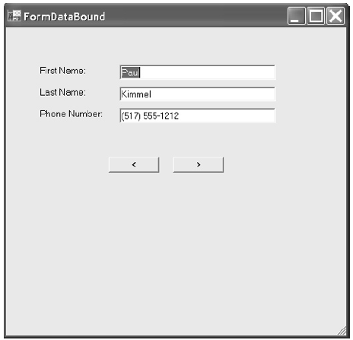
Implementing the UserControl
Create a UserControl named ContactInformation.
Add three Labels and three TextBox controls to ContactInformation. Change the Text property of the Labels to “First Name:”, “Last Name”, and “Phone Number:”.
Define three public properties named FirstName, LastName, and PhoneNumber.
Define the properties as string types.
The completed example is shown in Figure. Use the figure as a visual guide.

Slide 43
Implementing the UserControl
public string FirstName
{
get
{
return textBox1.Text;
}
set
{
textBox1.Text = value;
}
}
public string LastName
{
get
{
return textBox2.Text;
}
set
{
textBox2.Text = value;
}
}
public string PhoneNumber
{
get
{
return textBox3.Text;
}
set
{
textBox3.Text = value;
}
}

Slide 44
Implementing the ContactInformation Class
1: public class Contacts
2: {
3: private ArrayList items;
4:
5: public Contacts()
6: {
7: items = new ArrayList();
8: }
9:
10: public ArrayList Items
11: {
12: get
13: {
14: return items;
15: }
16: }
17: }
18:
19: public class Contact
20: {
21: private string firstName;
22: private string lastName;
23: private string phoneNumber;
24:
25: public Contact( string firstName, string lastName, string phoneNumber)
26: {
27: his.firstName = firstName;
28: this.lastName = lastName;
29: this.phoneNumber = phoneNumber;
30: }
31:
32: public string FirstName
33: {
34: get
35: {
36: return firstName;
37: }
38: set
39: {
40: firstName = value;
41: }
42: }
43:
44: public string LastName
45: {
46: get
47: {
48: return lastName;
49: }
50: set
51: {
52: lastName = value;
53: }
54: }
55:
56: public string PhoneNumber
57: {
58: get
59: {
60: return phoneNumber;
61: }
62: set
63: {
64: phoneNumber = value;
65: }
66: }
67: }

Slide 45
Binding and Navigating
1: Contacts c = new Contacts();
2:
3: private void FormDataBound_Load(object sender, System.EventArgs e)
4: {
5: c.Items.Add( new Contact("Paul", "Kimmel", "(517) 555-1212"));
6: c.Items.Add( new Contact("Trevor", "MacDonald", "(517) 555-1212"));
7:
8: contactInformation1.DataBindings.Add(
9: new Binding("FirstName", c.Items, "FirstName"));
10:
11: contactInformation1.DataBindings.Add(
12: new Binding("LastName", c.Items, "LastName"));
13:
14: contactInformation1.DataBindings.Add(
15: new Binding("PhoneNumber", c.Items, "PhoneNumber"));
16: }
17:
18: private void buttonNext_Click(object sender, System.EventArgs e)
19: {
20: ((CurrencyManager)contactInformation1.
21: BindingContext[c.Items]).Position -= 1;
22: }
23:
24: private void buttonPrevious_Click(object sender, System.EventArgs e)
25: {
26: ((CurrencyManager)contactInformation1.
27: BindingContext[c.Items]).Position += 1;
28: }

Slide 46
Custom Painting in UserControls
When you add constituent controls to a custom UserControl, you will have to provide custom painting for the constituent controls in each particular control’s Paint event handler.
Suppose we wanted to make the labels for our ContactInformation UserControl appear embossed. (Embossing is an effect that makes the text appear to have depth.) Using a System.Windows.Forms.
Label control painted on the UserControl, we would need to implement an event handler to handle the Label’s Paint event, as the following code demonstrates:
this.label1.Paint += new System.Windows.Forms.PaintEventHandler(this.label1_Paint);
private void label1_Paint(object sender, System.Windows.Forms.PaintEventArgs e)
{
// Demonstrates text customization
Label l = (sender as Label);
e.Graphics.DrawString(l.Text, l.Font, Brushes.White, new PointF(2,0));
}

Slide 47
Transparent UserControl Background
To allow your custom UserControls to be transparent, you will need to set the control style to support a transparent background. This is easily accomplished by calling the SetStyle method in the UserControl’s constructor, as demonstrated here:
SetStyle(ControlStyles.SupportsTransparentBackColor, true);

Slide 48
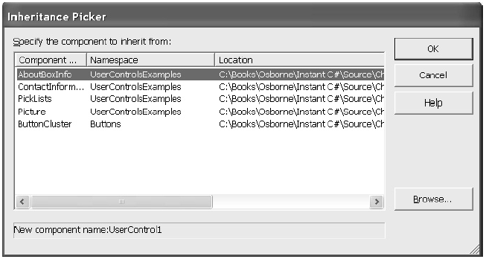
Extending UserControls Through Inheritance
You can extend existing UserControls through inheritance.
From the Project menu, select Add Inherited Control.
The Add New Items dialog will open, with the Inherited User Control template selected.
After you click OK, the Inheritance Picker dialog (Figure ) will be displayed.
Select one of the controls from the current solution or browse for an additional DLL assembly. Add the new behavior and state information, and then compile and test your custom control.

Slide 49
Using BeginUpdate and EndUpdate
If you write code that adds a large number of elements to a ListBox, each added item will force the ListBox to update, incurring the overhead of repainting the list each time an element is added. For big lists, this can result in very poor performance.
Instead, every time you load items to a ListBox (or ComboBox) one element at a time, you can precede loading the items with a call to BeginUpdate and follow the load process with an EndUpdate. You can include a try finally block to ensure that the EndUpdate method is invoked. The code that follows demonstrates loading 100,000 integer objects to a ListBox.
private void LoadListBox()
{
listBox1.BeginUpdate();
try
{
for(int i=0; i<100000; i++)
listBox1.Items.Add(i);
}
finally
{
listBox1.EndUpdate();
}
}

Slide 50
Using the ThreadPool to Load a ListBox
There are several ways to use threads in .NET. One of the easiest is to use a thread available in the ThreadPool.
The ThreadPool class contains a pool of threads that you can send work to in the form of a delegate.
Define the delegate to perform the work of loading the ListBox and send the delegate to the ThreadPool.QueueUserWorkItem. Additionally, Windows Forms are not directly thread-safe.
You must call the control’s Invoke method to interact with a Windows Forms control on the same thread on which it was created.
1: private delegate void Add(int i);
2:
3: private void AddItem(int i)
4: {
5: listBox1.Items.Add(i);
6: Application.DoEvents();
7: }
8:
9: private void LoadListBox(object state)
10: {
11: for( int i=0; i<100000; i++)
12: listBox1.Invoke(new Add(AddItem), new object[]{i});
13: }
14:
15: private void Form1_Load(object sender, System.EventArgs e)
16: {
17: System.Threading.ThreadPool.QueueUserWorkItem(
18: new System.Threading.WaitCallback(LoadListBox));
19: }

Slide 51
Using the ThreadPool to Load a ListBox
To load the ListBox using the ThreadPool class, we need to complete several steps.
The first step is to define a delegate type that reflects a procedure we will use to interact with the Form’s thread.
Line 1 defines a new delegate, Add, using a method signature that takes an integer and returns void.
In Listing, lines 3 through 7 define a method that will interact with the ListBox directly.
AddItem inserts a single item at a time and calls DoEvents to help flush the message queue of the Form’s thread.
Lines 9 through 13 represent the method that will run on its own thread.
LoadListBox takes a single argument, an object.
A method that returns void and takes an object has the same signature as a WaitCallback delegate.
LoadListBox iterates through a loop and invokes the AddItem method.
We use listBox1.Invoke—Invoke is thread-safe—to ensure that items are actually added to the list on the same thread that the ListBox lives on.
Lines 15 through 19 ask the ThreadPool to perform some work. ThreadPool .QueueUserWorkItem places work in the form of a WaitCallback delegate in the ThreadPool queue.
The ThreadPool invokes the delegate method using an available Thread or spins up a new one. Either way, we only care that the ThreadPool does its job.

Slide 52
Creating the Rectangle
To ensure that the second time the text is written it is written in the same rectangular region as the original text, we can use the ClientRectangle of the Label itself.
To create a specific text effect, we need to slightly offset the text the second time it is drawn.
A shallow shadow effect can be created by offsetting the text the second time by X–1 and Y–1, where X and Y represent the upper-left position of the ClientRectangle.
Other effects can be created changing the text offset values.
Implementing a truly flexible solution means that we ultimately let the consumer specify the offsetting values.
While prototyping, it is sufficient to use literal values.

Slide 53
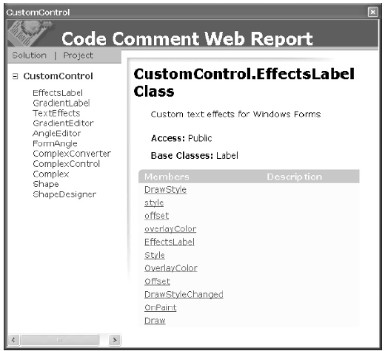
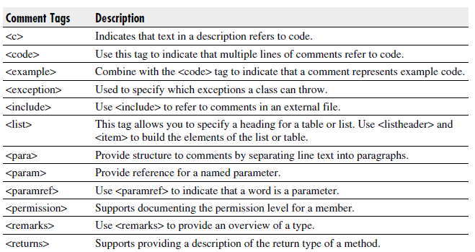
Auto Documentation Feature
1: /// <summary>
2: /// Custom text effects for Windows Forms
3: /// </summary>
4: [ToolboxBitmap(
5: @"EffectsLabel2.bmp")]
6: //[ToolboxBitmap(typeof(Label))]
The three hash mark (///) comments that can be used to generate documentation for your code.
The Tools | Build Comment Web Pages menu option will incorporate comments tagged with three hash marks into HTML help documentation.
Figure shows the comment on line 2 incorporated into the help documentation for the EffectsLabel.
In addition to using the three hash marks for documenting your code, you can use special XML tags to create other documentation features. Table lists the comment tags for generating documentation.

Slide 54
Defining the Category
19: [Description("Describes the appearance of the label's text."),
20: Category("Appearance")]
21: public DrawStyle Style
22: {
23: get
24: {
25: return style;
26: }
The Properties window organizes properties either alphabetically or by category.
This is to help consumers find properties at design time.
The CategoryAttribute is demonstrated in Line 20 demonstrates the CategoryAttribute.
We are indicating that the DrawStyle is categorized as an Appearance property.
If you click the Categorized utton in the Properties window, then the properties for the selected control will be displayed by category, as shown in Figure

Slide 55
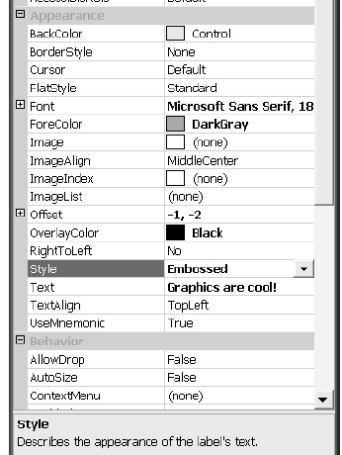
Providing a Description
At the bottom of the Properties window is a description of the selected property.
This value didn’t get there by accident.
The DescriptionAttribute takes a string argument.
The text used to initialize the DescriptionAttribute will be displayed at the bottom of the Properties window unless you deselect the Description context menu item.

Slide 56
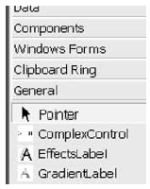
Adding a Custom Bitmap for Your Control
If you want your control to have a custom bitmap, then you can apply the ToolboxBitmapAttribute to the class.
This attribute can refer to an external bitmap file or use type information to request an existing icon for an existing control.
[ToolboxBitmap(@"c:\temp\EffectsLabel2.bmp")]
//[ToolboxBitmap(typeof(Label))]
The first statement demonstrates how to associate an external bitmap with our control (see Figure ), and the second (commented) statement demonstrates how to request the type information for the Label control.
If we use the second attribute statement, then our EffectsLabel will have the same icon as the Label control.
To create a custom 16×16 pixel bitmap for the EffectsLabel, you can use the Project | Add New Item menu and add a Bitmap to the solution.
This step will automatically open the Image editor, which will allow you to draw a custom bitmap.
The Image editor works like the Paint program that is provided with Windows.

Slide 57
Testing Your Component
An easy way to test your custom control is to add an application to the solution containing the control. I
f the control is a Windows Forms control, then add a Windows application to the solution.
Add a project reference to the control in your Windows application, and programmatically create and invoke methods that exercise the behavior of your custom control.
Code to test a Windows Forms control can be placed in the Load event handler for a Form.

Slide 58
Implementing Trap Behavior
You can verify that all code paths work to some degree by simply exercising those paths.
Exercising a path simply means that you compile and test the code, providing test data that takes all possible branches within your code.
This won’t test your code for all possible states, but it will help you ensure that there are no obvious, embarrassing defects.
A good technique for ensuring that you have exercised all states is to implement a trap.
A trap is a method that is called that halts processing when a code path has been executed.
You can implement a trap simply by calling the Debug.
Assert method with the argument False.
If you place a trap at each code branch and comment out the traps each time one is triggered, you have a record verifying that all branches have been tested.
Remove all of the comments to reset the traps if you need to run the tests after your component is updated.
Here is a statement that demonstrates the technique. (This statement assumes that you have included a using statement with the System.Diagnostics namespace in the module containing the trap.)
Debug.Assert(false);

Slide 59
Adding the Component to the Toolbox
After you have created your custom control, you will want to incorporate the control into the Toolbox.
This step is accomplished by selecting Tools | Customize Toolbox and browsing to the assembly containing the custom control.
You can add additional tabs to the Toolbox through the Toolbox context menu and drag your controls to their own tabs.
After you have added your control to the Toolbox, you can drag and drop instances of the control to Forms.
When you add a control to your application from the Toolbox, an instance of the control is added to the Form and a reference to the assembly is added to the list of References in the solution.
If you modify your control, then you may need to Reset the Toolbox and re-add the modified assembly to the Toolbox. (If changes to the control do not seem to be reflected in your application, then remove the reference to the control’s assembly and Reset the Toolbox, adding the updated list of assemblies referenced by the Toolbox.)

Slide 60
Creating a Merge Module
Thus far we have built and tested a custom control and installed it in our Toolbox.
Suppose you want to distribute your control to other developers.
To reliably distribute your control with your applications, you will need to create a Merge Module Project.
Merge Module Projects are defined as template projects in Visual Studio .NET. The recommended process is to define a Merge Module Project for every custom control and include all of the files, resources, registry entries, and setup logic necessary to install your custom control.
Merge Modules contain version information for a component, ensuring that components are not removed when other application assemblies have dependencies on those components.
For this reason, a new Merge Module should be created for every version of your component after a Merge Module has been added to an Installer file.
Merge Modules cannot be installed directly; a Merge Module must be installed as part of a Windows Installer (.msi) file.

Slide 61
Creating a Merge Module
Follow the numbered steps provided next to add a Merge Module Project to the solution containing the Custom Control, add the output from the CustomControl project to the Merge Module, and create a Windows Installer.
1. Select File | Add Project | New Project and select the Merge Module Project template from the Add New Project dialog. (The Merge Module Project is a template in the Setup and Deployment Projects folder.)
2. Provide a meaningful name for the Merge Module and click OK. (I used CustomControls.msm for the EffectsLabel assembly.)
3. Select the Merge Module Project in the Solution Explorer, and click Project | Add | Project Output to open the Add Project Output Group dialog (shown in Figure 9-5).
4. Repeat step 1. This time, select the Setup Project template.
5. Select the Setup Project in the Solution Explorer, and select Project | Add | Merge Module. The Merge Modules explorer dialog will be displayed. Navigate to the CustomControls.msm Merge Module and click OK.
6. When the Setup Project is compiled, the Windows Installer, setup, and .ini files will be copied or created in the Setup Project folder.

Slide 62
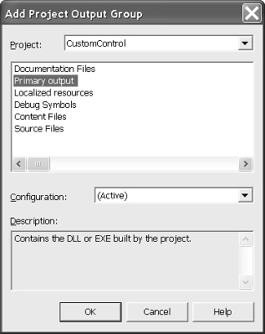
Creating a Merge Module
The primary output from the Setup Project is the setup.msi file.
This file contains the application files, registry settings, dependent files like our CustomControl.dll, and instructions for installing these files.

Slide 63
Creating a Merge Module
The primary output from the Setup Project is the setup.msi file.
This file contains the application files, registry settings, dependent files like our CustomControl.dll, and instructions for installing these files.

Slide 64
DLL’s

Slide 65
DLL Basics
Dynamic-link libraries (DLLs) have been the cornerstone of Microsoft Windows since the first version of the operating system.
All the functions in the Windows API are contained in DLLs.
The three most important DLLs are Kernel32.dll, which contains functions for managing memory, processes, and threads; User32.dll, which contains functions for performing user-interface tasks such as window creation and message sending; and GDI32.dll, which contains functions for drawing graphical images and displaying text.
Windows also comes with several other DLLs that offer functions for performing more specialized tasks.
For example, AdvAPI32.dll contains functions for object security, registry manipulation, and event logging; ComDlg32.dll contains the common dialog boxes (such as File Open and File Save); and ComCtl32.DLL supports all of the common window controls.

Slide 66
Reasons for using DLLs:
They extend the features of an application. Since DLLs can be dynamically loaded into a process's address space, an application can determine at run time what actions to perform and then load the code to execute those actions on demand. For example, a DLL is useful when one company creates a product and wants to allow other companies to extend or enhance the product.
They can be written in many programming languages. You can choose the best language for the job at hand. Perhaps your application's user interface is best programmed with Microsoft Visual Basic, but the business logic is better handled by C++. The system allows a Visual Basic program to load a C++ DLL, a Cobol DLL, a Fortran DLL, and so on.
They simplify project management. If different groups work on different modules during the development process, the project is easier to manage.

Slide 67
Reasons for using DLLs:
They help conserve memory. If two or more applications use the same DLL, the DLL has its pages in RAM once and the pages are shared by all of the applications. The C/C++ run-time library is a perfect example. Many applications use this library. If all these applications link to the static library, the code for functions such as sprintf, strcpy, malloc, and so on exist in memory multiple times. However, if all these applications link to the DLL C/C++ run-time library, the code for these functions is in memory only once, which means that memory is used more efficiently.
They facilitate resource sharing. DLLs can contain resources such as dialog box templates, strings, icons, and bitmaps. Multiple applications can use DLLs to share these resources.
They facilitate localization. Applications frequently use DLLs to localize themselves. For example, an application that contains only code and no user interface components can load the DLL containing localized user interface components.

Slide 68
Reasons for using DLLs:
They help resolve platform differences. The various versions of Windows offer different functions. Frequently, developers want to call new functions if they exist on the host version. However, if your source code contains a call to a new function and your application is about to run on a version of Windows that doesn't offer that function, the operating system loader will refuse to run your process.
They can serve special purposes. You can extend Windows Explorer's shell by creating COM objects that must live inside a DLL. The same is true for ActiveX controls that can be loaded by a Web browser to create rich Web pages.

Slide 69
DLLs and a Process's Address Space
It is often easier to create a DLL than to create an application because a DLL usually consists of a set of autonomous functions that any application can use.
There is usually no support code for processing message loops or creating windows within DLLs.
A DLL is simply a set of source code modules, with each module containing a set of functions that an application (executable file) or another DLL will call.
After all the source code files have been compiled, they are linked by the linker just as an application's executable file would be.
However, for a DLL you must specify the /DLL switch to the linker.
This switch causes the linker to emit slightly different information into the resulting DLL file image so that the operating system loader recognizes the file image as a DLL rather than an application.

Slide 70
DLLs and a Process's Address Space
Before an application (or another DLL) can call functions in a DLL, the DLL's file image must be mapped into the calling process's address space.
Once a DLL's file image is mapped into the calling process's address space, the DLL's functions are available to all the threads running within the process.
In fact, the DLL loses almost all of its identity as a DLL:
To the threads in the process, the DLL's code and data simply look like additional code and data that happen to be in the process's address space.
When a thread calls a DLL function, the DLL function looks at the thread's stack to retrieve its passed parameters and uses the thread's stack for any local variables that it needs.
In addition, any objects created by code in the DLL's functions are owned by the calling thread or process—a DLL never owns anything.

Slide 71
Building a DLL requires the following steps:
You must first create a header file, which contains the function prototypes, structures, and symbols that you want to export from the DLL.
You create the C/C++ source code module (or modules) that implements the functions and variables that you want in the DLL module. Since these source code modules are not required to build an executable module, the DLL company's source code can remain a company secret.
Building the DLL module causes the compiler to process each source code module, producing an .obj module (one .obj module per source code module).

Slide 72
Building a DLL requires the following steps:
After all of the .obj modules are created, the linker combines the contents of all the .obj modules and produces a single DLL image file. This image file (or module) contains all the binary code and global/static data variables for the DLL. This file is required in order to execute the executable module.
If the linker detects that the DLL's source code module exports at least one function or variable, the linker also produces a single .lib file. This .lib file is small because it contains no functions or variables. It simply lists all the exported function and variable symbol names. This file is required in order to build the executable module.

Slide 73
Once you build the DLL module, you can build the executable module. These steps are:
In all of the source modules that reference functions, variables, data structures, or symbols, you must include the header file created by the DLL developer.
You create the C/C++ source code module (or modules) that implements the functions and variables that you want in the executable module. The code can, of course, reference functions and variables defined in the DLL's header file.
Building the executable module causes the compiler to process each source code module, producing an .obj module (one .obj module per source code module).
After all of the .obj modules are created, the linker combines the contents of all the .obj modules and produces a single executable image file. This image file (or module) contains all the binary code and global/static data variables for the executable. The executable module also contains an import section that lists all the DLL module names required by this executable. In addition, for each DLL name listed, the section indicates which function and variable symbols are referenced by the executable's binary code. The operating system loader parses the import section, as you'll see in a moment.

Slide 74
Once the DLL and the executable modules are built, a process can execute. When you attempt to run the executable module, the operating system's loader performs the following steps:
The loader creates a virtual address space for the new process. The executable module is mapped into the new process's address space. The loader parses the executable module's import section. For every DLL name listed in the section, the loader locates the DLL module on the user's system and maps that DLL into the process's address space. Note that since a DLL module can import functions and variables from another DLL module, a DLL module might have its own import section. To fully initialize a process, the loader parses every module's import section and maps all required DLL modules into the process's address space. As you can see, initializing a process can be time consuming.

