Slide 1
Unidad IV
Interfaz Gráfica de Usuario (GUI)
  4.1 Creación de interfaz gráfica para usuarios.
    4.1.1 Librería de interfaz gráfica (API’s).
    4.1.2 Aplicaciones GUI.
  4.2 Computación gráfica.
    4.2.1 Área de dibujo.
    4.2.2 Primitivas de dibujo (línea, arco,
    circulo, colores, rellenos,
    imágenes).

Slide 2
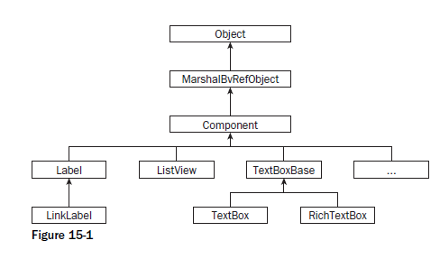
Controls
You may not notice it, but when you work with Windows Forms, you are working with the System .Windows.Forms namespace.
This namespace is included in the using directives in one of the files that holds the Form class.
Most controls in .NET derive from the System.Windows.Forms.Control class.
This class defines the basic functionality of the controls, which is why many properties and events in the controls you ’ ll see are identical.
Many of these classes are themselves base classes for other controls, as is the case with the Label and TextBoxBase classes .

Slide 3
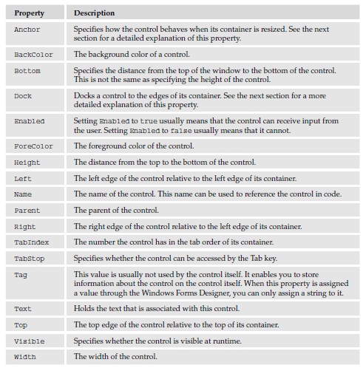
Properties
All controls have a number of properties that are used to manipulate the behavior of the control.
The base class of most controls, System.Windows.Forms.Control , has several properties that other controls either inherit directly or override to provide some kind of custom behavior.

Slide 4
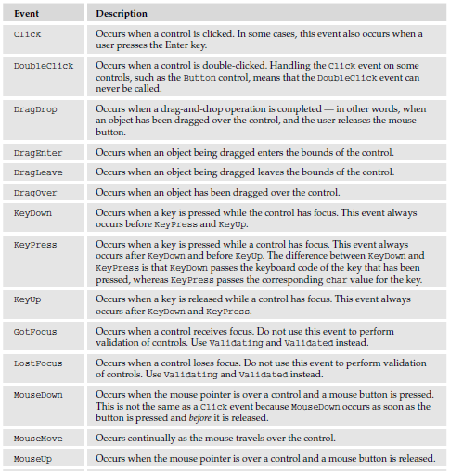
Events
The Control class defines a number of events that are common to the controls you use in this chapter.
The following table describes a number of these events.
Again, this is just a selection of the most common events; to see the entire list, refer to the .NET Framework SDK documentation.

Slide 5
The Button Control
The System.Windows.Forms namespace provides three controls that derive from ButtonBase : Button , CheckBox , and RadioButton .

Slide 6
The Label and LinkLabel Controls
The Label control is probably the most frequently used control of them all. Look at any Windows application and you see a label on just about every dialog you find. Label is a simple control with one purpose only — to display text on the form.
The .NET Framework includes two label controls that present themselves in two distinct ways:
  Label , the standard Windows label .
  LinkLabel , a label similar to the standard one (and derived from it) but that presents itself as an Internet link (a hyperlink) .

Slide 7
The TextBox Control
Text boxes should be used whenever you want users to enter text that you have no knowledge of at design time (e.g., the user ’ s name).
The primary function of a text box is for users to enter text, but any characters can be entered, and you can force users to enter numeric values only.
The .NET Framework comes with two basic controls to take text input from users: TextBox and RichTextBox .
Both controls are derived from a base class called TextBoxBase , which itself is derived from Control .
TextBoxBase provides the base functionality for text manipulation in a text box, such as selecting text, cutting to and pasting from the clipboard, and a wide range of events.

Slide 8
The RadioButton and CheckBox Controls
Radio buttons traditionally display themselves as a label with a tiny circle to the left of it, which can be either selected or not.
You should use the radio buttons when you want to give users a choice between several mutually exclusive options.
To group radio buttons together so they create one logical unit you must use a GroupBox control or some other container.
When you first place a GroupBox onto a form and then place the RadioButton controls you need within the borders of the GroupBox , the RadioButton controls will automatically change their state to reflect that only one option within the group box can be selected.
If you do not place the controls within a GroupBox , only one RadioButton on the form can be selected at any given time.
A CheckBox control traditionally displays itself as a label with a small box on its immediate left.
Use a check box when you want to enable users to choose one or more options — for example, a questionnaire asking which operating systems the user has tried (e.g., Windows XP, Windows Vista, Linux, and so on).

Slide 9
The GroupBox Control
The GroupBox control is often used to logically group a set of controls such as the RadioButton and CheckBox , and to provide a caption and a frame around this set.
Using the group box is as simple as dragging it onto a form and then dragging the controls it should contain onto it (but not the reverse — that is, you can ’ t lay a group box over preexisting controls).
The effect of this is that the parent of the controls becomes the group box, rather than the form, so it is possible to have more than one radio button selected at any given time.
Within the group box, however, only one radio button can be selected.
The relationship between parent and child probably needs to be explained a bit more.
When a control is placed on a form, the form is said to become the parent of the control, and hence the control is the child of the form.
When you place a GroupBox on a form, it becomes a child of a form.
Because a group box can itself contain controls, it becomes the parent of these controls.
The effect of this is that moving the GroupBox control moves all of the controls placed on it.
Another effect of placing controls on a group box is that it enables you to affect the contained controls by setting the corresponding property on the group box.
For instance, if you want to disable all the controls within a GroupBox control, you can simply set the Enabled property of the GroupBox to false .

Slide 10
The RichTextBox Control
Like the normal TextBox , the RichTextBox control is derived from TextBoxBase .
Because of this, it shares a number of features with the TextBox , but is much more diverse.
Whereas a TextBox is commonly used for the purpose of obtaining short text strings from the user, the RichTextBox is used to display and enter formatted text (e.g., bold , underline , and italic ). It does so using a standard for formatted text called Rich Text Format, or RTF.

Slide 11
The ListBox and CheckedListBox Controls
List boxes are used to show a list of strings from which one or more can be selected at a time. Just like check boxes and radio buttons, the list box provides a way to ask users to make one or more selections.
You should use a list box when at design time you don ’ t know the actual number of values the user can choose from (e.g., a list of co - workers).
Even if you know all the possible values at design time, you should consider using a list box if there are a large number of values.
The ListBox class is derived from the ListControl class, which provides the basic functionality for list - type controls that ship with the .NET Framework.
Another kind of list box available is called CheckedListBox . Derived from the ListBox class, it provides a list just like the ListBox does, but in addition to the text strings it provides a check for each item in the list.

Slide 12
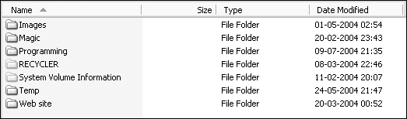
The ListView Control
The list view is usually used to present data for which the user is allowed some control over the detail and style of its presentation.
It is possible to display the data contained in the control as columns and rows much like in a grid, as a single column, or with varying icon representations.
The most commonly used list view is like the one shown earlier, which is used to navigate the folders on a computer.
The ListView control is easily the most complex control you encounter in this chapter, and covering all of its aspects is beyond the scope of this book.

Slide 13
The ListView Control
The list view is usually used to present data for which the user is allowed some control over the detail and style of its presentation.
It is possible to display the data contained in the control as columns and rows much like in a grid, as a single column, or with varying icon representations.
The most commonly used list view is like the one shown earlier, which is used to navigate the folders on a computer.
The ListView control is easily the most complex control you encounter in this chapter, and covering all of its aspects is beyond the scope of this book.

Slide 14
The ImageList Control
The ImageList control provides a collection that can be used to store images used in other controls on your form.
You can store images of any size in an image list, but within each control every image must be of the same size. In the case of the ListView , this means that you need two ImageList controls to be able to display both large and small images.
The ImageList is the first control you visit in this chapter that does not display itself at runtime.
When you drag it to a form you are developing, it is not placed on the form itself, but below it in a tray, which contains all such components.
This nice feature is provided to prevent controls that are not part of the user interface from cluttering up the Forms Designer.
The control is manipulated in exactly the same way as any other control, except that you cannot move it onto the form.
You can add images to the ImageList at both design time and runtime.
If you know at design time what images you want to display, then you can add the images by clicking the button at the right side of the Images property.
This will bring up a dialog in which you can browse to the images you want to insert.
If you choose to add the images at runtime, you add them through the Images collection.

Slide 15
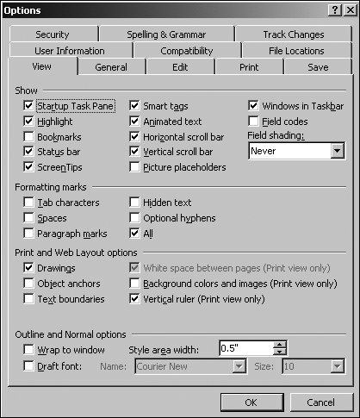
The TabControl Control
The TabControl control provides an easy way to organize a dialog into logical parts that can be accessed through tabs located at the top of the control. A TabControl contains TabPages that essentially work like a GroupBox control, in that they group controls together, although they are somewhat more complex.

Slide 16
Using the MenuStrip Control
In addition to the MenuStrip control, several additional controls are used to populate a menu.
The three most common of these are the ToolStripMenuItem , ToolStripDropDown , and the ToolStripSeparator .
All of these controls represent a particular way to view an item in a menu or toolbar.
The ToolStripMenuItem represents a single entry in a menu, the ToolStripDropDown represents an item that when clicked displays a list of other items, and the ToolStripSeparator represents a horizontal or vertical dividing line in a menu or toolbar.
There is another kind of menu that is discussed briefly after the discussion of the MenuStrip — the ContextMenuStrip .
A context menu appears when a user right - clicks on an item, and typically displays information relevant to that item.

Slide 17
Toolbars
While menus are great for providing access to a multitude of functionality in your application, some items benefit from being placed in a toolbar as well as on the menu.
A toolbar provides one - click access to such frequently used functionality as Open, Save, and so on.
A button on a toolbar usually displays a picture and no text, though it is possible to have buttons with both.
In addition to buttons, you will occasionally see combo boxes and text boxes in the toolbars too.
If you let the mouse pointer hover above a button in a toolbar, it will often display a tooltip, which provides information about the purpose of the button, especially when only an icon is displayed.
The ToolStrip , like the MenuStrip , has been made with a professional look and feel in mind.
When users see a toolbar, they expect to be able to move it around and position it wherever they want it.
The ToolStrip enables users to do just that — that is, if you allow them to.

Slide 18
StatusStrip
The last of the small family of strip controls is the StatusStrip .
This control represents the bar that you find at the bottom of the dialog in many applications.
The bar is typically used to display brief information about the current state of the application — a good example is Word ’ s display of the current page, column, line, and so on in the status bar as you are typing.
The StatusStrip is derived from the ToolStrip , and you should be quite familiar with the view that is presented as you drag the control onto your form.
Three of the four possible controls that can be used in the StatusStrip — ToolStripDropDownButton , ToolStripProgressBar , and ToolStripSplitButton — were presented earlier.
That leaves just one control that is specific to the StatusStrip : the StatusStripStatusLabel , which is also the default item you get.

Slide 19
SDI and MDI Applications
Traditionally, three kinds of applications can be programmed for Windows:
Dialog - based applications : These present themselves to the user as a single dialog from which all functionality can be reached.
Single - document interfaces (SDI) : These present themselves to the user with a menu, one or more toolbars, and one window in which the user can perform some task.
Multiple - document interfaces (MDI) : These present themselves to the user in the same manner as an SDI, but are capable of holding multiple open windows at one time.

Slide 20
SDI and MDI Applications
Dialog - based applications are usually small, single - purpose applications aimed at a specific task that needs a minimum of data to be entered by the user or that target a very specific type of data.
Single - document interfaces are each usually aimed at solving one specific task because they enable users to load a single document into the application to be worked on. This task, however, usually involves a lot of user interaction, and users often want the capability to save or load the result of their work. Good examples of SDI applications are WordPad) and Paint, both of which come with Windows.
However, only one document can be open at any one time, so if a user wants to open a second document, then a fresh instance of the SDI application must be opened, and it will have no reference to the first instance. Any configuration you do to one instance is not carried over into the other. For example, in one instance of Paint you might set the drawing color to red, and when you open a second instance of Paint, the drawing color is the default, which is black.
Multiple - document interfaces are much the same as SDI applications, except that they are able to hold more than one document open in different windows at any given time.

Slide 21
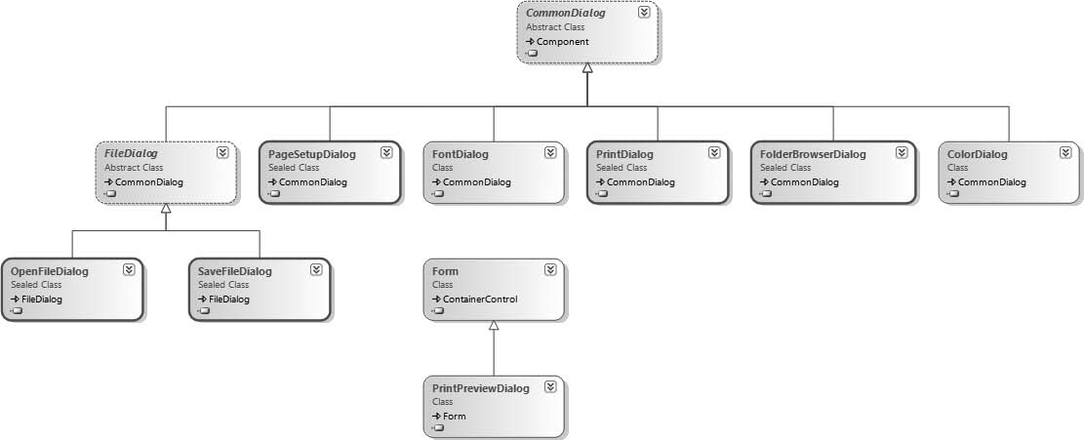
Common Dialogs
A dialog is a window that is displayed within the context of another window.
With a dialog, you can ask the user to enter some data before the flow of the program continues.
A common dialog is one that is used to get information from the user that most applications typically require, such as the name of a file, and is a part of the Windows operating system.

Slide 22
File Dialogs
With a file dialog, the user can select a drive and browse through the file system to select a file. From the file dialog, all you want returned is a filename from the user.
The OpenFileDialog enables users to select by name the file they want to open. The SaveFileDialog , in contrast, enables users to specify a name for a file they want to save.
These dialog classes are similar because they derive from the same abstract base class, though there are some properties unique to each class.
In this section, you look first at the features of the OpenFileDialog , then at how the SaveFileDialog differs, and you develop a sample application that uses both of them.

Slide 23
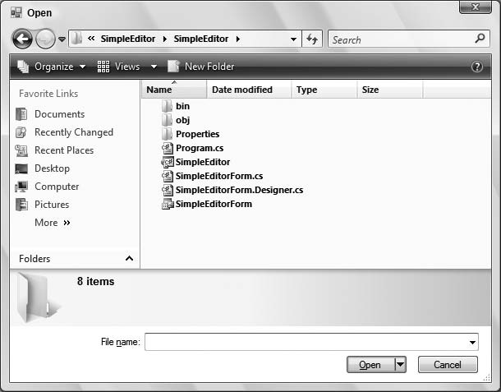
OpenFileDialog
The OpenFileDialog class enables users to select a file to open. As shown in the preceding example, a new instance of the OpenFileDialog class is created before the ShowDialog() method is called:
  OpenFileDialog dlg = new OpenFileDialog();
  dlg.ShowDialog();

Slide 24
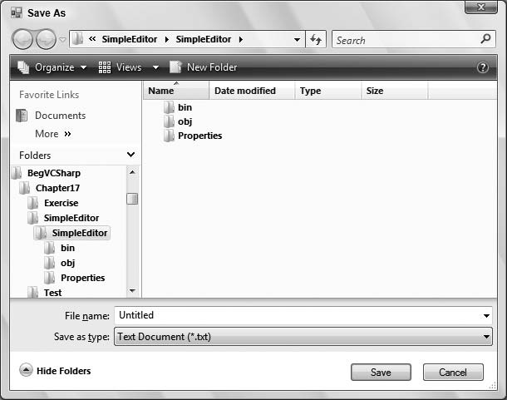
SaveFileDialog
The SaveFileDialog class is very similar to the OpenFileDialog , and they have a set of common properties. This section focuses on the properties specific to the Save dialog, and explains how the application of the common properties differs.

Slide 25
Printing
With printing there are many things to worry about, such as the selection of a printer, page settings, and how to print multiple pages.
By using classes from the System.Drawing.Printing namespace, you can get a lot of help with these challenges, and print documents from your own applications with ease.
Before looking at the PrintDialog class that makes it possible to select a printer, take a quick look at how .NET handles printing.
The foundation of printing is the PrintDocument class, which has a Print() method that starts a chain of calls culminating in a call to OnPrintPage() , which is responsible for passing the output to the printer.
However, before learning how to implement printing code, first consider the .NET printing classes.

Slide 26
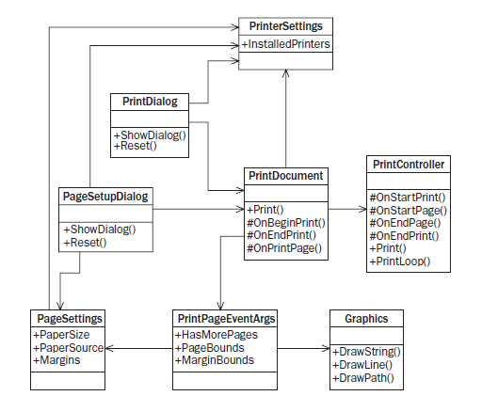
Printing Architecture

Slide 27
Printing Architecture
Let ’ s look at the functionality of these classes:
  The PrintDocument class is the most important class. In Figure 17 - 18 , you can see that nearly all other classes are related to this class. To print a document, an instance of PrintDocument is required. The following section looks at the printing sequence initiated by this class.
  The PrintController class controls the flow of a print job. The print controller has events for the start of the printing, for each page, and for the end of the printing. The class is abstract because the implementation of normal printing is different from that of print preview. Concrete classes that derive from PrintController are StandardPrintController and PreviewPrintController .
  You will not find the methods Print() and PrintLoop() in the documentation because these methods are internal to the assembly and can be invoked only by other classes in the same assembly, such as the PrintDocument class. However, these methods help you understand the printing process, which is why they are shown here.
  The PrinterSettings class can get and set the printer configurations, such as duplex printing, landscape or portrait, and number of copies.

Slide 28
Printing Architecture
Let ’ s look at the functionality of these classes:
  The PrintDocument class is the most important class. In Figure 17 - 18 , you can see that nearly all other classes are related to this class. To print a document, an instance of PrintDocument is required. The following section looks at the printing sequence initiated by this class.
  The PrintController class controls the flow of a print job. The print controller has events for the start of the printing, for each page, and for the end of the printing. The class is abstract because the implementation of normal printing is different from that of print preview. Concrete classes that derive from PrintController are StandardPrintController and PreviewPrintController .
  You will not find the methods Print() and PrintLoop() in the documentation because these methods are internal to the assembly and can be invoked only by other classes in the same assembly, such as the PrintDocument class. However, these methods help you understand the printing process, which is why they are shown here.
  The PrinterSettings class can get and set the printer configurations, such as duplex printing, landscape or portrait, and number of copies.
  The PrintDialog class contains options for selecting which printer to print to and how the PrinterSettings should be onfigured. This class is derived from CommonDialog like the other dialog classes already described.
  The PageSettings class specifies the sizes and boundaries of a page, and whether the page is in black and white or color. You can configure this class with the PageSetupDialog class, which is a CommonDialog .

Slide 29
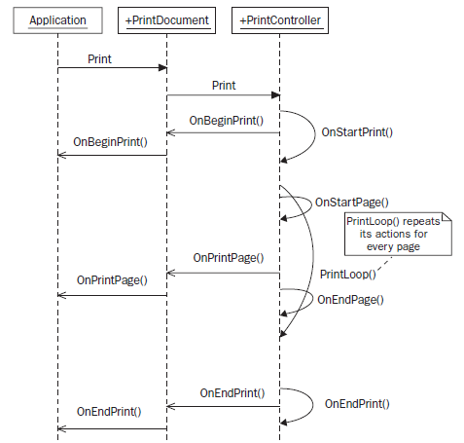
Printing Sequence
Now that you know about the roles of the classes in the printing architecture, let ’ s look at the main printing sequence. Figure shows the major players — your application, an instance of the PrintDocument class, and a PrintController , in a timely sequence.

Slide 30
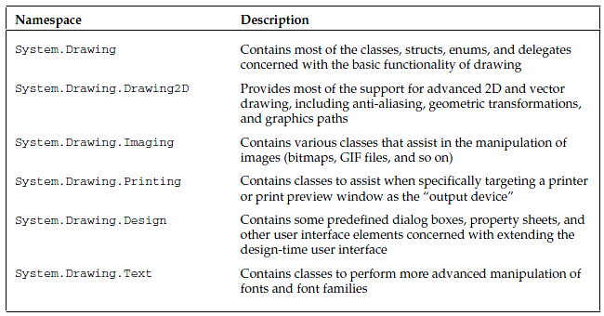
GDI+ Namespaces
The following table provides an overview of the main namespaces you will need to explore to find the GDI+ base classes.

Slide 31
GDI+ Namespaces
The following table provides an overview of the main namespaces you will need to explore to find the GDI+ base classes.

Slide 32
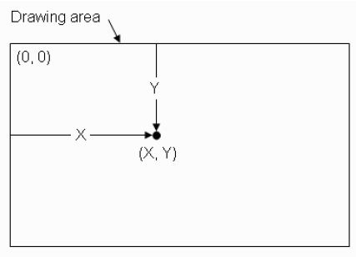
Coordinate Systems
By default, the origin of all three coordinate systems is at point (0, 0), which is located at the upper left corner of the drawing area.
The X coordinate represents the distance from the left edge of the drawing area to the point, and the Y coordinate represents the distance from the top edge of the drawing area to the point.
Figure shows how the X and Y coordinates of a point relate to the drawing area.
The default unit for all three of these coordinate systems is pixels. The coordinate system can be customized by shifting the origin to another location in the client area, and by setting a different unit of measure.

Slide 33
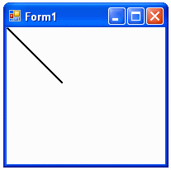
Coordinate Systems
using System;
using System.Drawing;
using System.Windows.Forms;
namespace Example1_1
{
  public partial class Form1 : Form
  {
    public Form1()
    {
      InitializeComponent();
      this.SetStyle(ControlStyles.ResizeRedraw, true);
      this.BackColor = Color.White;
      }
      protected override void OnPaint(PaintEventArgs e)
      {
      Graphics g = e.Graphics;
      // Following codes draw a line from (0, 0) to (1, 1) in unit of inch:
      g.PageUnit = GraphicsUnit.Inch;
      Pen blackPen = new Pen(Color.Black, 1 / g.DpiX);
      g.DrawLine(blackPen, 0, 0, 1, 1);
    }
  }
}

Slide 34
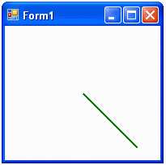
Coordinate Systems
Let’s now move the origin to the centre of the client area and draw the line again. This can be done by changing the OnPaint method of Example1_1 to the following:
  protected override void OnPaint(PaintEventArgs e)
  {
    Graphics g = e.Graphics;
    // Following codes shift the origin to the center of the client area, and
    // then draw a line from (0,0) to (1,1):
    g.PageUnit = GraphicsUnit.Inch;
    g.TranslateTransform((ClientRectangle.Width / g.DpiX) / 2,
    (ClientRectangle.Height / g.DpiY) / 2);
    Pen greenPen = new Pen(Color.Green, 1 / g.DpiX);
    g.DrawLine(greenPen, 0, 0, 1, 1);
  }

Slide 35
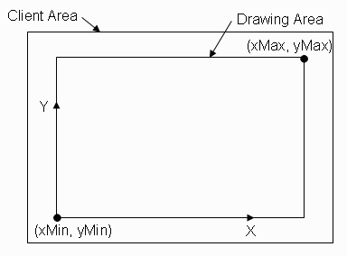
Custom Coordinates
An application can define its own coordinate system.
This coordinate system is independent of the unit of your realworld graphics objects, and its Y-axis points from bottom to top as it does in most chart applications. In this system, the page coordinate system is identical to the device system, and the unit for both systems is in pixels.
Inside the Client Area, a drawing area is defined with an offset margin. The conventional X-Y coordinate system can be defined within the drawing area. Here we will demonstrate how to achieve this with C#.

Slide 36
Custom Coordinates
Create a new Visual C# Windows Application project, and name it Example1-2. The following is
the code listing of Form1.cs:
  using System;
  using System.Drawing;
  using System.Windows.Forms;
  namespace Example1_2
  {
    public partial class Form1 : Form
    {
      // Define the drawing area
      private Rectangle PlotArea;
      // Unit defined in world coordinate system:
      private float xMin = 0f;
      private float xMax = 10f;
      private float yMin = 0f;
      private float yMax = 10f;
      // Define the offset in pixel:
      private int offset = 30;
      public Form1()
      {
      InitializeComponent();
      this.SetStyle(ControlStyles.ResizeRedraw, true);
      this.BackColor = Color.White;
      }
      protected override void OnPaint(PaintEventArgs e)
      {
        Graphics g = e.Graphics;
        // Calculate the location and size of the drawing area
        // within which we want to draw the graphics:
        Rectangle rect = ClientRectangle;
        PlotArea = new Rectangle(rect.Location, rect.Size);
        PlotArea.Inflate(-offset, -offset);
        //Draw ClientRectangle and PlotArea using Pen:
        g.DrawRectangle(Pens.Red, rect);
        g.DrawRectangle(Pens.Black, PlotArea);
        // Draw a line from point (3,2) to Point (6, 7)
        // using a Pen with a width of 3 pixels:
        Pen aPen = new Pen(Color.Green, 3);
        g.DrawLine(aPen, Point2D(new PointF(3, 2)), Point2D(new PointF(6, 7)));
        aPen.Dispose();
        g.Dispose();
      }
      private PointF Point2D(PointF ptf)
      {
        PointF aPoint = new PointF();
        aPoint.X = PlotArea.X + (ptf.X - xMin) *
        PlotArea.Width / (xMax - xMin);
        aPoint.Y = PlotArea.Bottom - (ptf.Y - yMin) *
        PlotArea.Height / (yMax - yMin);
        return aPoint;
      }
    }
  }

Slide 37
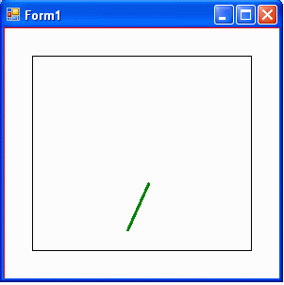
Zooming
The size and position of the “Window” determine which part of the graphics object is drawn.
The relative size of the Window and viewport determine the scale at which the graphics object is displayed on the screen.
For a given viewport or PlotArea, a relatively large Window produces a small graphics object, because you are drawing a large piece of the custom coordinate space into a small viewport (PlotArea).
On the other hand, a relatively small Window produces a large graphics object.
Therefore, you can increase the size of the Window (specified by the X and Y axis limits) to see the “zooming out” effect by changing the parameters: xMin, xMax, yMin, and yMax in Example1_2, discussed in the previous section:
  private float xMin = -10f;
  private float xMax = 20f;
  private float yMin = 0f;
  private float yMax = 20f;

Slide 38
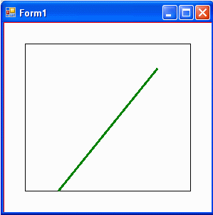
Zooming
  On the other hand, if you decrease the Window size, the line appears larger on the screen; basically, you have a “zoom in” effect. Change the parameters in Example to the following:
  private float xMin = 2f;
  private float xMax = 7f;
  private float yMin = 2f;
  private float yMax = 8f;

Slide 39
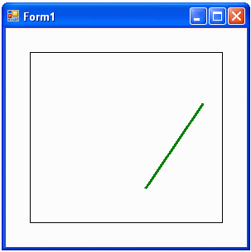
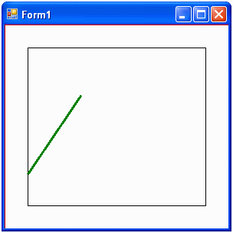
Panning
Panning is defined as the moving of all graphics objects in the scene by shifting the Window. In a panning process, the Window size is kept unchanged. For example, you can move the Window to the left by changing the code in Example
  // Moving original window left 3 units:
  private float xMin = -3f ;
  private float xMax = 7;
  private float yMin = 0f;
  private float yMax = 10f;
This produces the result shown in Figure which is equivalent to moving the line toward the right side of the drawing area. On the other hand, if we move the Window to the right by use of the following code:
  // Moving original Window right in 3 units:
  private float xMin = 3f ;
  private float xMax = 13;
  private float yMin = 0f;
  private float yMax = 10f;

Slide 40
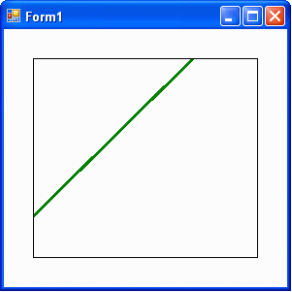
Panning
        drawingPanel.Paint += new PaintEventHandler(drawingPanelPaint);
        drawingPanel.BorderStyle = BorderStyle.FixedSingle;
        drawingPanel.Anchor = AnchorStyles.Bottom;
        drawingPanel.Anchor = AnchorStyles.Left;
        drawingPanel.Anchor = AnchorStyles.Right;
        drawingPanel.Anchor = AnchorStyles.Top;
      }
      private void drawingPanelPaint(object sender, PaintEventArgs e)
      {
        drawingPanel.Left = offset;
        drawingPanel.Top = offset;
        drawingPanel.Width = ClientRectangle.Width - 2 * offset;
        drawingPanel.Height = ClientRectangle.Height - 2 * offset;
        Graphics g = e.Graphics;
        Pen aPen = new Pen(Color.Green, 3);
        g.DrawLine(aPen, Point2D(new PointF(2, 3)),
        Point2D(new PointF(6, 7)));
        aPen.Dispose();
        g.Dispose();
      }
      private PointF Point2D(PointF ptf)
      {
        PointF aPoint = new PointF();
        aPoint.X = (ptf.X - xMin) * drawingPanel.Width / (xMax - xMin);
        aPoint.Y = drawingPanel.Height - (ptf.Y - yMin) *
        drawingPanel.Height / (yMax - yMin);
        return aPoint;
      }
    }
  }
Here we will use a Panel control to achieve this goal. Let’s start off by creating a new C# Windows Application project and calling it Example1_3. Select a Panel control from the Toolbox, drag it over the empty Form1, and rename the panel control to drawingPanel. The following is the code listing of Form1.cs:
  using System;
  using System.Drawing;
  using System.Windows.Forms;
  namespace Example1_3
  {
    public partial class Form1 : Form
    {
      // Unit defined in world coordinate system:
      private float xMin = 0f;
      private float xMax = 10f;
      private float yMin = 0f;
      private float yMax = 10f;
      // Unit in pixel:
      private int offset = 30;
      public Form1()
      {
        InitializeComponent();
        this.SetStyle(ControlStyles.ResizeRedraw, true);
        this.BackColor = Color.White;
        // Subscribing to a paint eventhandler to drawingPanel:

Slide 41
Pen and Brush
Graphics objects provide an interface between the application program and the display device (the computer screen).
After creating a Graphics object, you can use it to draw lines and fill shapes.
However, even though the Graphics class provides the platform to draw on, you still need a tool to draw with.
Two basic tools you will often use are the Pen and Brush.
The GDI+ library provides the Pen and Brush through the Pen and Brush classes respectively.
You use the Pen class to draw lines, curves, and outlines of shapes.
You use the Brush class to fill shapes with colors and patterns.

Slide 42
Pen Class
You use the Pen class to create custom pens with specified color and width properties.
The line drawn by a Pen object can be filled in a variety of fill styles, including solid colors and textures.
The fill style depends on the brush or texture that is used as the fill object.
There are four different types of constructors for the Pen class: two constructors allow you to specify a Brush object instead of color, and two constructors give you the option of specifying the pen’s width.
These four constructors are as follows:
  Creates a new instance of the Pen class with the specified Color:
  public Pen(color);
  Creates a new instance of the Pen class with the specified Brush:
  public Pen(brush);
  Creates a new instance of the Pen class with the specified Brush and width:
  public Pen(brush, float);
  Creates a new instance of the Pen class with the specified Color and width:
  public Pen(color, float);

Slide 43
Pen Class
The Pen class has a number of properties, offering you a large amount of control over how your Pen object draws graphics elements. The most commonly used properties include:
• Alignment – Gets or sets the alignment for the Pen object.
• Brush – Gets or sets the Brush object that determines the attributes of the Pen object.
• Color – Gets or sets the color of the Pen object.
• DashStyle – Gets or sets the style used for dashed lines drawn with the Pen object.
• Width – Gets or sets the width of the Pen object.

Slide 44
Brush Class
The brushes are used to fill shapes with colors, patterns, and images. The Brush class is an abstract base class and cannot be instantiated. In order to create a Brush object, you must use its derived classes, which include:
• SolidBrush – This class defines a brush made of a single color.
• TextureBrush – This class defines a brush that uses an image to fill the interior of a shape.
• HatchBrush – This class defines a rectangle brush with a hatch style, a foreground color, and a background color.
• LinearGradientBrush – This class encapsulates both two-color gradients and custom multicolor gradients.
• PathGradientBrush – This class encapsulates a Brush object that fills the interior of a GraphicsPath object with a gradient.

Slide 45
Brush Class
The following code snippet creates various brush objects:
  // Create a SolidBrush with red color:
  SolidBrush sb = new SolidBrush(Color.Red);
  // Create a TextureBrush with an image file (myImage.gif):
  Bitmap bmp = new Bitmap(“myImage.gif”);
  TextureBrush tb = new TextureBrush(bmp);
  // Create a HatchBrush with a Cross pattern:
  HatchBrush hb = new HatchBrush(HatchStyle.Cross,
  Color.Black, Color.White);
  // Create a LinearGradientBrush with a Gradient described by two points:
  LinearGradientBrush lgb = new LinearGradientBrush(New Point(10, 10),
  new Point(100, 30), Color.Red, Color.Black);
  // Create a PathGradientBrush for a Graphics path:
  PathGradientBrush pgb = new PathGradientBrush(graphicsPath);
  pgb.CenterColor = Color.Red;
  pgb.SurroundColors = new Color[] {Color.Black};

Slide 46
Points
In C# and GDI+, there are two point structures: Point and PointF.
The Point structure represents an ordered pair of integer X- and Y- coordinates that define a point in a 2D plane.
The Point constructor includes three overloaded methods that allow you to create a Point object from an integer, a size object, or two integers as follows:
  • Point() – Creates a Point object and initializes the X- and Y-data members to zeros. This is the default constructor.
  • Point(Size) – Creates a Point object using a Size object to initialize the X- and Y-data members.
  • Point(int, int) – Creates a Point object using two integers to initialize the X- and Y-data members.
The following code snippet creates Point objects using all three types of the constructors:
  Point pt1 = new Point();
  Point pt2 = new Point(new Size(10, 100));
  Point pt3 = new Point(20, 200);

Slide 47
Points
The PointF structure is similar to the Point structure, but uses floating-point values instead of integers.
Unlike the Point structure, PointF cannot take a Size or SizeF object. PointF has only two constructors PointF() and PointF(float, float).
Both the Point and PointF defines three properties:
  IsEmpty, X, and Y.
The IsEmpty property returns true if a point is empty, which means that both X and Y values are zero; otherwise it returns false.
The constructors, Point()and PointF()create an empty field with X and Y values set to zero.

Slide 48
Lines and Curves
Line objects include straight lines and curves.
A straight line can be created using the DrawLine method, which connects two points specified by coordinate pairs.
The following code snippet creates a straight line:
  Graphics g = new Graphics();
  g.DrawLine(Pens.Black, x1, y1, x2, y2 );
  g.DrawLine(Pens.Black, point1, point2);
where (x1, y1) is the starting point of the line and (x2, y2) is the endpoint of the line.
It is also possible to directly specify the start- and end-points using point1 and point2.
The coordinates or the points can be integers or float values.

Slide 49

Lines and Curves
The DrawCurve method creates a spline that passes through each point in a point array, and connects all points in a smooth way:
  Graphics g = new Graphics();
  g.DrawCurve(Pens.Black, new Point[]);
In these cases, only solid lines and curves are drawn.
However, lines and curves can have many different styles.
For example, you can draw a dash-line with a diamond starting cap and an arrow ending cap, as illustrated in Figure .
This shows that a line can have three parts: the line body, starting cap, and ending cap.

Slide 50
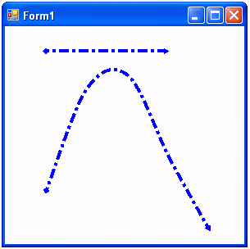
Lines and Curves
      aPen.StartCap = LineCap.DiamondAnchor;
      aPen.EndCap = LineCap.ArrowAnchor;
      aPen.DashStyle = DashStyle.DashDot;
      aPen.DashOffset = 50;
      //draw straight line:
      g.DrawLine(aPen, 50, 30, 200, 30);
      // define point array to draw a curve:
      Point point1 = new Point(50, 200);
      Point point2 = new Point(100, 75);
      Point point3 = new Point(150, 60);
      Point point4 = new Point(200, 160);
      Point point5 = new Point(250, 250);
      Point[] Points ={ point1, point2, point3, point4, point5};
      g.DrawCurve(aPen, Points);
      aPen.Dispose();
      g.Dispose();
    }
  }
}
using System;
using System.Drawing;
using System.Drawing.Drawing2D;
using System.Windows.Forms;
namespace Example1_4
{
  public partial class Form1 : Form
  {
    public Form1()
    {
    InitializeComponent();
    This.BackColor = Color.White;
    }
    protected override void OnPaint(PaintEventArgs e)
    {
      Graphics g = e.Graphics;
      // Create a pen object:
      Pen aPen = new Pen(Color.Blue, 4);
      // Set line caps and dash style:

Slide 51
Rectangles, Ellipses, and Arcs
The Rectangle and RectangleF structures represent a rectangle in C# and GDI+.
A Rectangle structure stores the top-left corner as well as the width and height of a rectangle region.
You can create a Rectangle object from the Point and Size objects or by using four integers or float values as the coordinates of the rectangle.
The Rectangle and RectangleF structures also provide properties which can be used to obtain the width, height, and position of the rectangle.
An ellipse is a circular shape defined by its bounding rectangle.
The DrawEllipe method will draw an empty ellipse within the bounding rectangle.
While DrawEllipse method draws a closed curve around the whole boundary of the ellipse, the DrawArc method draws part of the ellipse.
Which part is drawn is specified by a StartAngle and a SweepAngle.
The method DrawPie is also closely related to the ellipse.
You specify an ellipse by supplying the enclosing rectangle.
In addition, you specify a StartAngle and a SweepAngle to define where the pie starts, and how large of a section of the ellipse it spans.

Slide 52
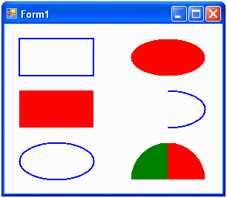
Rectangles, Ellipses, and Arcs
using System;
using System.Drawing;
using System.Windows.Forms;
namespace Example1_5
{
  public partial class Form1 : Form
  {
    public Form1()
    {
      InitializeComponent();
      SetStyle(ControlStyles.ResizeRedraw, true);
    }
    protected override void OnPaint(PaintEventArgs e)
    {
      Graphics g = e.Graphics;
      // Create a pen object:
      Pen aPen = new Pen(Color.Blue, 2);
      // Create a brush object with a transparent red color:
      SolidBrush aBrush = new SolidBrush(Color.Red);
      // Draw a rectangle:
      g.DrawRectangle(aPen, 20, 20, 100, 50);
using // Draw a filled rectangle:
      g.FillRectangle(aBrush, 20, 90, 100, 50);
      // Draw ellipse:
      g.DrawEllipse(aPen, new Rectangle(20, 160, 100, 50));
      // Draw filled ellipse:
      g.FillEllipse(aBrush, new Rectangle(170, 20, 100, 50));
      // Draw arc:
      g.DrawArc(aPen, new Rectangle(170, 90, 100, 50),
      -90, 180);
      g.FillPie(aBrush, new Rectangle(170, 160, 100, 100),
      -90, 90);
      g.FillPie(Brushes.Green,
      new Rectangle(170, 160, 100, 100), -90, -90);
    }
  }
}

Slide 53
Polygons
The polygon is one of the most important graphics objects we deal with when we render 2D and 3D graphics or process computational geometry.
The Graphics.DrawPolygon method draws a polygon defined by an array of point structures.
Every pair of two consecutive points in the array specifies a side of the polygon.
In addition, if the last point and the first point of the array do not coincide, it specifies the last side of the polygon.
The Graphics.FillPolygon method fills the interior of a polygon defined by an array of points specified by point structures.
In the following example, we will create a US flag object that contains fifty star polygons.
First we need to define the coordinates of a star.
As illustrated in Figure, we will assume that the center coordinates of the star are at (xc, yc), r1 is the radius of the inner circle, and r is the radius of the outer circle.
The angles α = 72 degrees and β = 36 degrees.
From this figure, we can easily determine the coordinates of points 0 to 9:

Slide 54
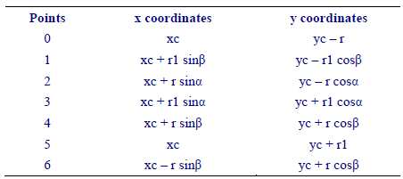
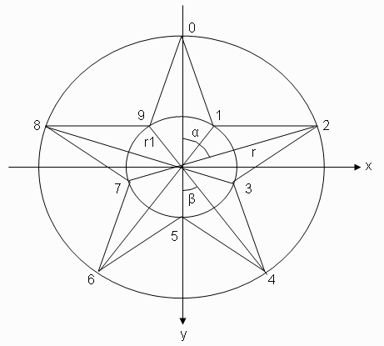

Polygons

Slide 55
Polygons
    private void DrawFlag(Graphics g, float x0, float y0, float width)
    {
      SolidBrush whiteBrush = new SolidBrush(Color.White);
      SolidBrush blueBrush = new SolidBrush(Color.FromArgb(0, 0, 128));
      SolidBrush redBrush = new SolidBrush(Color.Red);
      float height = 10 * width / 19;
      // Draw white rectangle background:
      g.FillRectangle(whiteBrush, x0, y0, width, height);
      // Draw seven red stripes.
      for (int i = 0; i < 7; i++)
      {
        g.FillRectangle(redBrush, x0,
        y0 + 2 * i * height / 13, width, height / 13);
      }
      // Draw blue box.
      // Size it so that it covers two fifths of the flag width
      // and the top four red stripes vertically.
      RectangleF blueBox = new RectangleF(x0, y0,
      2 * width / 5, 7 * height / 13);
      g.FillRectangle(blueBrush, blueBox);
      // Draw fifty stars in the blue box.
      // Divide the blue box into a grid of 11 x 9 squares and
using System;
using System.Drawing;
using System.Drawing.Drawing2D;
using System.Windows.Forms;
namespace Example1_6
{
  public partial class Form1 : Form
  {
    public Form1()
    {
      InitializeComponent();
      SetStyle(ControlStyles.ResizeRedraw, true);
      this.Width = 500;
      this.Height = 310;
      this.BackColor = Color.LightGreen;
    }
    protected override void OnPaint(PaintEventArgs e)
    {
      Graphics g = e.Graphics;
      g.SmoothingMode = SmoothingMode.AntiAlias;
      DrawFlag(g, 20, 20, this.Width - 50);
      g.Dispose();
    }

Slide 56
Polygons
      // r: determines the size of the star.
      // xc, yc: determine the location of the star.
      float sin36 = (float)Math.Sin(36.0 * Math.PI / 180.0);
      float sin72 = (float)Math.Sin(72.0 * Math.PI / 180.0);
      float cos36 = (float)Math.Cos(36.0 * Math.PI / 180.0);
      float cos72 = (float)Math.Cos(72.0 * Math.PI / 180.0);
      float r1 = r * cos72 / cos36;
      // Fill the star:
      PointF[] pts = new PointF[10];
      pts[0] = new PointF(xc, yc - r);
      pts[1] = new PointF(xc + r1 * sin36, yc - r1 * cos36);
      pts[2] = new PointF(xc + r * sin72, yc - r * cos72);
      pts[3] = new PointF(xc + r1 * sin72, yc + r1 * cos72);
      pts[4] = new PointF(xc + r * sin36, yc + r * cos36);
      pts[5] = new PointF(xc, yc + r1);
      pts[6] = new PointF(xc - r * sin36, yc + r * cos36);
      pts[7] = new PointF(xc - r1 * sin72, yc + r1 * cos72);
      pts[8] = new PointF(xc - r * sin72, yc - r * cos72);
      pts[9] = new PointF(xc - r1 * sin36, yc - r1 * cos36);
      g.FillPolygon(Brushes.White, pts);
    }
  }
}
      // place a star in every other square.
      float offset = blueBox.Width / 40;
      float dx = (blueBox.Width - 2 * offset) / 11;
      float dy = (blueBox.Height - 2 * offset) / 9;
      for (int j = 0; j < 9; j++)
      {
        float yc = y0 + offset + j * dy + dy / 2;
        for (int i = 0; i < 11; i++)
        {
          float xc = x0 + offset + i * dx + dx / 2;
          if ((i + j) % 2 == 0)
          {
          DrawStar(g, this.Width/55, xc, yc);
          }
        }
      }
      whiteBrush.Dispose();
      blueBrush.Dispose();
      redBrush.Dispose();
    }
    private void DrawStar(Graphics g, float r, float xc, float yc)
    {

Slide 57
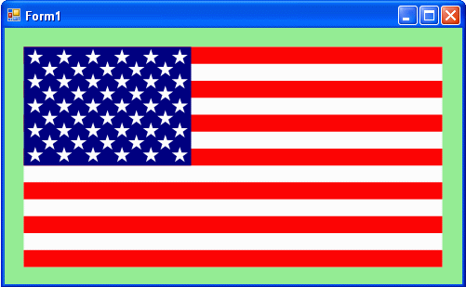
Polygons

Slide 58
Color
In C# and GDI+, color is specified as Color structures from the System.Drawing namespace. It is easy to create a color object using these color structures. There are several different ways of creating color in C#, including:
  • An ARGB (alpha, red, green, blue) color value. You specify each value as an integer in the range [0, 255].
  • An environment setting from the current color scheme. You choose the correspondingly named property from the system Color class.
  • A predefined .NET color name. You choose the correspondingly named property from the Color class.
  • An HTML color name. You specify this value as a string using the ColorTranslator class.
  • A Win32 color code. You specify this value as an integer (representing a hexadecimal value) using the ColorTranslator class.
  • An OLE color code. You specify this value as an integer (representing a hexadecimal value) using the ColorTranslator class.
  • A ColorDialog. You pick a color from the color palette.

Slide 59
System Colors
In C#, a color is represented by a 32-bit structure made up of four components: alpha (A), red (R), green (G), and blue (B), referred to as ARGB mode.
The components’ values range from 0 to 255.
The alpha component of the color represents transparency, which determines how such a color is blended with the background.
A zero alpha value represents a fully transparent color, while a value of 255 represents a fully opaque color.

Slide 60
System Colors
  // Create a color from an ARGB value
  int alpha = 100;
  int red = 255;
  int green = 0;
  int blue = 0;
  this.BackColor = Color.FromARGB(alpha, red, green, blue);
  // Create a color from an environment setting:
  this.BackColor = SystemColors.HighlightText;
  // Create a Color using a .NET name
  this.BackColor = Color.LightGray;
  // Create a color from an HTML code:
  this.BackColor = ColorTranslator.FromHTML(“Red”);
  // Create a color from a Win32 color code:
  this.BackColor = ColorTranslator.FromWin32(0xA000);
  // Create a color from an OLE color code:
  this.BackColor = ColorTranslator.FromOle(0xFF00);
  // Create a color from a ColorDialog():
  ColorDialog cdl = new ColorDialog();
  cdl.ShowDialog();
  this.BackColor = cdl.Color;

Slide 61
System Colors
  // Create a color from an ARGB value
  int alpha = 100;
  int red = 255;
  int green = 0;
  int blue = 0;
  this.BackColor = Color.FromARGB(alpha, red, green, blue);
  // Create a color from an environment setting:
  this.BackColor = SystemColors.HighlightText;
  // Create a Color using a .NET name
  this.BackColor = Color.LightGray;
  // Create a color from an HTML code:
  this.BackColor = ColorTranslator.FromHTML(“Red”);
  // Create a color from a Win32 color code:
  this.BackColor = ColorTranslator.FromWin32(0xA000);
  // Create a color from an OLE color code:
  this.BackColor = ColorTranslator.FromOle(0xFF00);
  // Create a color from a ColorDialog():
  ColorDialog cdl = new ColorDialog();
  cdl.ShowDialog();
  this.BackColor = cdl.Color;

Slide 62
System Colors
    {
      KnownColor selectedColor =
      (KnownColor)Enum.Parse(typeof(KnownColor), listBox1.Text);
      panel1.BackColor = Color.FromKnownColor(selectedColor);
      ColorInfo();
    }
    private void button1_Click(object sender, EventArgs e)
    {
      cdl.ShowDialog();
      panel1.BackColor = cdl.Color;
      ColorInfo();
    }
    private void ColorInfo()
    {
      // Show color information on the labels:
      // Brightness info:
      lblBrightness.Text = "Brightness = " +
      panel1.BackColor.GetBrightness().ToString();
      lblHue.Text = "Hue = " +
      panel1.BackColor.GetHue().ToString();
      // HUE Info:
      lblSaturation.Text = "Saturation = " +
      panel1.BackColor.GetSaturation().ToString();
using System;
using System.Drawing;
using System.Windows.Forms;
namespace Example1_7
{
  public partial class Form1 : Form
  {
    ColorDialog cdl = new ColorDialog();
    public Form1()
    {
    InitializeComponent();
    }
    private void Form1_Load(object sender, EventArgs e)
    {
      string[] colorNames = Enum.GetNames(typeof(KnownColor));
      listBox1.Items.AddRange(colorNames);
    }
    private void listBox1_SelectedIndexChanged(object sender,
    EventArgs e)

Slide 63
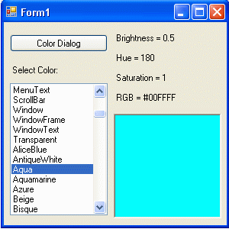
System Colors
      // RGB Hex info:
      string strRGBHex = string.Format("0x{0:X8}",
      panel1.BackColor.ToArgb());
      strRGBHex = "RGB = #" + strRGBHex.Substring(
      strRGBHex.Length - 6, 6);
      lblRGBHex.Text = strRGBHex;
      // ARGB value info:
      string strRGBValue = "ARGB = [" +
      panel1.BackColor.A.ToString() + ", " +
      panel1.BackColor.R.ToString() + ", " +
      panel1.BackColor.G.ToString() + ", " +
      panel1.BackColor.B.ToString() + "]";
      lblRGBValue.Text = strRGBValue;
    }
  }
}

Slide 64
System Colors
      // RGB Hex info:
      string strRGBHex = string.Format("0x{0:X8}",
      panel1.BackColor.ToArgb());
      strRGBHex = "RGB = #" + strRGBHex.Substring(
      strRGBHex.Length - 6, 6);
      lblRGBHex.Text = strRGBHex;
      // ARGB value info:
      string strRGBValue = "ARGB = [" +
      panel1.BackColor.A.ToString() + ", " +
      panel1.BackColor.R.ToString() + ", " +
      panel1.BackColor.G.ToString() + ", " +
      panel1.BackColor.B.ToString() + "]";
      lblRGBValue.Text = strRGBValue;
    }
  }
}

