Slide 1
Unidad III Programación concurrente multihilo.
Programación concurrente multihilo.
3.1 Concepto de Hilo.
3.2 Comparación de un programa de flujo
único contra uno de flujo múltiple.
3.3 Creación y control de hilos.
3.3.1 Atributos de hilos.
3.3.2 Creación e Inicialización de
hilos.
3.3.3 Arranque de hilos.
3.3.4 Manipulación de hilos.
3.3.5 Suspensión de hilos.
3.3.6 Parada de hilos.
3.4 Sincronización de hilos.
3.4.1 Mutex.
3.4.2 Semáforos.
3.4.3 Barreras (Barrier).

Slide 2
What are Processes
When a user starts an Application, memory and a whole host of resources are allocated for the Application.
The pysichal seperation of this memory and resources is called a Process.
An Application may launch more than 1 Process.
Its important to note that Applications and Processes are not the same thing at all.
Each Process has an execution sequence used by the computers CPU.
This execution sequence is known as a Thread.

Slide 3
Multithreaded Processes
What happens if we need our Process to do more than 1 thing, like query a web service and write to a database at the same time.
Luckily we can split a Process to share the time slice allocated to it.
This is done by spawning new threads in the current Process.
These extra threads are sometimes called worker threads.
These worker threads share the processes memory space that is isolated from all other Processes on the system.
The concept of spawning new threads within the same process is called free threading.

Slide 4
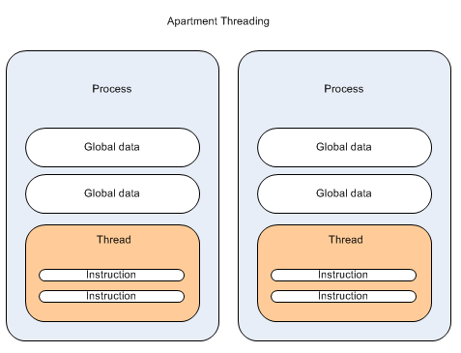
Apartment threading
Each new thread is started in its own process and is granted its own data, so threads couldn't share data
With this model each time you want to do some background work it happens in its own process, so was known as Out Of Process.

Slide 5
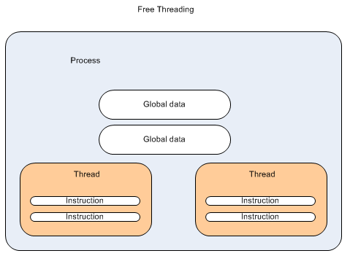
Free threading
Free threading we can get the CPU to execute an additional thread using the same process data.
This is much better than single threaded apartments, as we get all the added benifits of extra threads with the ability to share the same Process data.
NOTE : Only one thread actually runs on the CPU at one time.

Slide 6
Thread Local Storage
When a threads time slice has expired it doesnt just stop and wait its turn.
Recall that a CPU can only run 1 thread at a time, so the current thread needs to be replaced with the next thread to get some CPU time.
Before that happens the current thread needs to store its state information to allow it to execute properly again.
This is what the TLS is all about.
One of the registers stored in the TLS is the program counter, which tells the thread which instruction to execute next.

Slide 7
AppDomains
Microsoft also introduced 1 extra layer of abstraction/isolation called an AppDomain.
The AppDomain is not a physical isolation, but rather a logic isolation within the Process.
Since more than 1 AppDomain can exist in Process we get some benifits.
For example until we had an AppDomain Processes that needed to access each others data had to use a Proxy, which introduced extra code and overhead.
By using a AppDomain it is possible to launch several applications within the same Process.
The same sort of isolation that exists with Processes is also available for AppDomain.
Threads can execure across application domains without the overhead of inter process communication.
This is all encapsulated within the AppDomain class.
Any time a namespace is loaded in an application it is loaded into an AppDomain.
The AppDomain used will be the same as the calling code unless otherwise specified.
AppDomain may or may not contain threads, which is different to Processes.

Slide 8
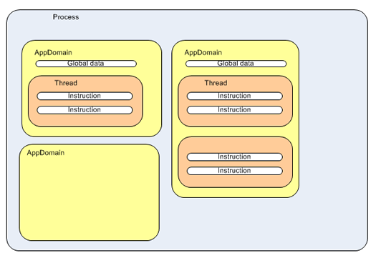
AppDomains

Slide 9
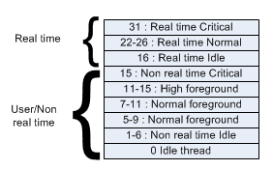
Thread Priorities
Just as in real life we as human have priorities, so to do Threads.
A programmer can decide a priority for their Thread, but ultimately its up the recipient to decide what should be acted upon now, and what can wait.
Windows uses a priority system from 0-31 where 31 is the higest.
Anything higher than 15 needs to be done via an Administrator.
Threads that have priority between 16-31 are considered real time and will pre-empt lower priority level threads.
Think about drivers/input devices and things like this, these will be running with priorities between 16-31.

Slide 10
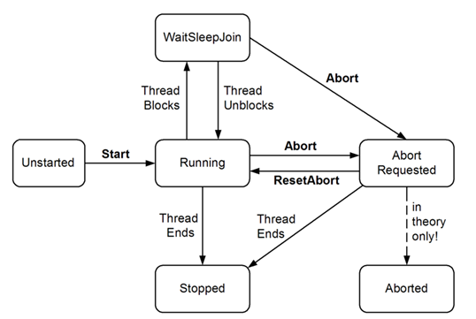
Lifecyle Of Threads
The following figure illustrates the most common thread states, and what happens to move a thread into each state

Slide 11
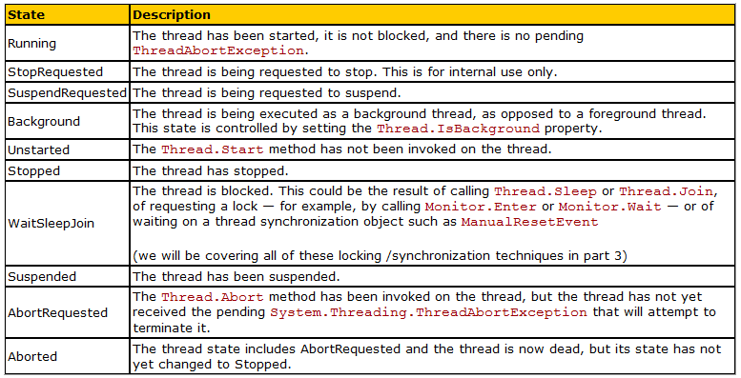
Lifecyle Of Threads
Here a list of all the available thread states

Slide 12
Starting Threads
The simplest way to create a thread is to create a new instance of the Thread class.
The Thread constructor takes a single argument: a delegate instance.
The CLR provides the ThreadStart delegate class specifically for this purpose, which points to a method you designate.
This allows you to construct a thread and to say to it, “When you start, run this method.”
The ThreadStart delegate declaration is:
public delegate void ThreadStart( );
As you can see, the method you attach to this delegate must take no parameters and must return void.
Thus, you might create a new thread like this:
Thread myThread = new Thread( new ThreadStart(myFunc) );
myFunc must be a method that takes no parameters and returns void.

Slide 13
Starting Threads
For example, you might create two worker threads, one that counts up from zero:
public void Incrementer( )
{
for (int i =0;i<10;i++)
{
Console.WriteLine("Incrementer: {0}", i);
}
}
and one that counts down from 10:
public void Decrementer( )
{
for (int i = 10;i>=0;i--)
{
Console.WriteLine("Decrementer: {0}", i);
}
}

Slide 14
Starting Threads
To run these in threads, create two new threads, each initialized with a ThreadStart delegate.
These in turn would be initialized to the respective member functions:
Thread t1 = new Thread( new ThreadStart(Incrementer) );
Thread t2 = new Thread( new ThreadStart(Decrementer) );
Instantiating these threads does not start them running.
To do so you must call the Start method on the Thread object itself:
t1.Start( );
t2.Start( );

Slide 15
Starting Threads
Thread t1 = new Thread( new ThreadStart(Incrementer) );
// create a thread for the Decrementer
// pass in a ThreadStart delegate
// with the address of Decrementer
Thread t2 = new Thread( new ThreadStart(Decrementer) );
// start the threads
t1.Start( );
t2.Start( );
}
// demo function, counts up to 1K
public void Incrementer( )
{
for (int i =0;i<1000;i++)
{
Console.WriteLine( "Incrementer: {0}", i);
}
}
// demo function, counts down from 1k
public void Decrementer( )
{
for (int i = 1000;i>=0;i--)
{
Console.WriteLine( "Decrementer: {0}", i);
}
}
}
}
namespace Programming_CSharp
{
using System;
using System.Threading;
class Tester
{
static void Main( )
{
// make an instance of this class
Tester t = new Tester( );
// run outside static Main
t.DoTest( );
}
public void DoTest( )
{
// create a thread for the Incrementer
// pass in a ThreadStart delegate
// with the address of Incrementer

Slide 16
Joining Threads
The Join method (without any parameters) blocks the calling thread until the current thread is terminated.
It should be noted that the caller will block indefinitely if the current thread does not terminate.
If the thread has already terminated when Join method is called, the method returns immediately.
The Join method has an override, which lets you set the number of milliseconds to wait on the thread to finish.
If thread has not finished when the timer expires, Join exits and returns control to the calling thread (and the joined thread continues to execute).
This method is quite useful if one thread depends on another thread.

Slide 17
Joining Threads
When you tell a thread to stop processing and wait until a second thread completes its work, you are said to be joining the first thread to the second.
It is as if you tied the tip of the first thread on to the tail of the second—hence "joining" them. To join thread 1 (t1) onto thread 2 (t2), write:
t2.Join( );
If this statement is executed in a method in thread t1, t1 will halt and wait until t2 completes and exits.
For example, we might ask the thread in which Main( ) executes to wait for all our other threads to end before it writes its concluding message.
In this next code snippet, assume you've created a collection of threads named myThreads.
Iterate over the collection, joining the current thread to each thread in the collection in turn:
foreach (Thread myThread in myThreads)
{
myThread.Join( );
}
Console.WriteLine("All my threads are done.");

Slide 18
Sleep
The static Thread.Sleep method available on the Thread class is fairly simple, it simply Suspends the current thread for a specified time.
Consider the following example, where 2 threads are started that run 2 seperate counter methods, the 1st thread (T1) counts from 0-50 and the 2nd thread (T2) counts from 51-100.
Thread T1 will go to sleep for 1 second when it reaches 10, and thread T2 will go to sleep for 5 seconds when it reaches 70.

Slide 19
Suspending Threads
At times, you want to suspend your thread for a short while.
You might, for example, like your clock thread to suspend for about a second in between testing the system time.
This lets you display the new time about once a second without devoting hundreds of millions of machine cycles to the effort.
The Thread class offers a public static method, Sleep, for just this purpose.
The method is overloaded; one version takes an int, the other a timeSpan object. Each represents the number of milliseconds you want the thread suspended for, expressed either as an int (e.g., 2000 = 2000 milliseconds or 2 seconds) or as a timeSpan.
To cause your thread to sleep for one second, you can invoke the static method of Thread. Sleep, which suspends the thread in which it is invoked:
Thread.Sleep(1000);

Slide 20
Interrupt
When a thread is put to sleep, the thread goes into the WaitSleepJoin state.
If the thread is in this state it may be placed back in the scheduling queue by the use of the Interrupt method.
Calling Interrupt when a thread is in the WaitSleepJoin state will cause a ThreadInterruptedException to be thrown, so any code that is written needs to catch this.
If this thread is not currently blocked in a wait, sleep, or join state, it will be interrupted when it next begins to block.

Slide 21
Interrupts
Processes don't need to know about each other to be scheduled correctly.
That's really the job of the operation system, even OS have a main thread sometimes called the system thread, which schedules all other threads.
It does this by using interrupts.
An interrupt is a mechanism that causes the normal execution flow to branch somewhere else in the computer memory without the knowledge of the execution program. the OS determines how much time the thread has to execute and places and places an instruction in the current threads execution sequence.
Since the interrupt is within the instruction set its a software interrupt, which isn't the same as a hardware interrupt.
Interrupts are a feature used in all but the simplest microprocessors to allow hardware devices to request attention.
When an interrupt is received, a microprocessor will temporarily suspend execution of the code it was running and jump to a special program called an interrupt handler.
The interrupt handler will typically service the device needing attention and then return to the previously-executing code.

Slide 22
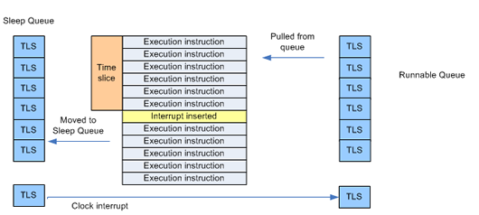
Thread Sleep And Clock Interrupts
A thread may decide to yield its CPU time to wait for a resource, but this could be 10 or 20 minutes, so the programmer may choose to make the thread sleep, which results in the thread being packed in the TLS.
But it doesn't go to the run able queue it goes to a sleep queue.
In order for threads in the sleep queue to run again they need a different kind of interrupt, called a clock interrupt.
When a thread enters the sleep queue a new clock interrupt is scheduled for the time that the thread when the thread should be awoken.
When a clock interrupt occurs that matches an entry on the sleep queue the thread is moved back to the runnable queue.

Slide 23
Abort
A blocked thread can also be forcibly released via its Abort method.
This has an effect similar to calling Interrupt, except that a ThreadAbortException is thrown instead of a ThreadInterruptedException.
Furthermore, the exception will be re-thrown at the end of the catch block (in an attempt to terminate the thread for good) unless Thread.
ResetAbort is called within the catch block.
In the interim, the thread has a ThreadState of AbortRequested.
The big difference, though, between Interrupt and Abort, is what happens when it's called on a thread that is not blocked.
While Interrupt waits until the thread next blocks before doing anything,
Abort throws an exception on the thread right where it's executing – maybe not even in your code.
Aborting a non-blocked thread can have significant consequences"

Slide 24
Killing Threads
Typically, threads die after running their course. You can, however, ask a thread to kill itself by calling its Abort( ) method.
You might wish to kill a thread in reaction to an event, such as the user pressing the Cancel button.
t1.Abort( );

Slide 25
Synchronization
Three synchronization mechanisms:
the Interlock class,
the C# lock statement,
and the Monitor class.

Slide 26
Wait Handles
Allows threads to wait on a particular WaitHandle, and only proceed when the WaitHandle tells the waiting thread it is ok to proceed.
This mechanism is know as signalling and waiting.
When a thread is waiting on a WaitHandle it is blocked until such a time that the WaitHandle is signalled, which allows the waiting thread to be unblocked and proceed with its work.

Slide 27
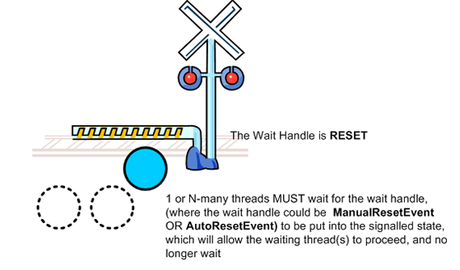
Wait Handles

Slide 28
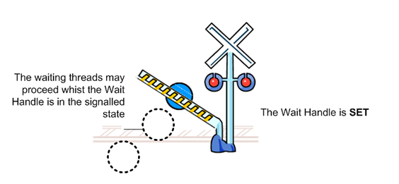
Wait Handles

Slide 29
Wait Handles
The following classes are provided for us
System.Threading.WaitHandle
System.Threading.EventWaitHandle
System.Threading.Mutex
System.Threading.Semaphore
As can be seen in this heirachy, System.Threading.WaitHandle is the base class for a bunch of other System.Threading.WaitHandle derived classes.

Slide 30
SignalAndWait
There are several overloads for this method, but the basic idea is that one System.Threading.WaitHandle will be signalled whilst another System.Threading.WaitHandle will be waited on to receive a signal.

Slide 31
WaitAll (Static method on WaitHandle)
There are several overloads for this method, but the basic idea is that an array of System.Threading.WaitHandles is passed into to the WaitAll method, and ALL of these System.Threading.WaitHandle will be waited on to receive a signal.

Slide 32
WaitAny (Static method on WaitHandle)
There are several overloads for this method, but the basic idea is that an array of System.Threading.WaitHandles is passed into to the WaitAny method, and ANY of these System.Threading.WaitHandle will be waited on to receive a signal.

Slide 33
WaitOne
There are several overloads for this method, but the basic idea is the current System.Threading.WaitHandle will be waited on to receive a signal.
Let us now concentrate on System.Threading.EventWaitHandle

Slide 34
EventWaitHandle
The EventWaitHandle is a WaitHandle and has 2 more specific classes, ManualResetEvent and AutoResetEvent, that inherit from it that are used more commonly.
As such it is these 2 sub classes that I will spend time discussing. All that you need to note is that an EventWaitHandle object, is able to act just like either of its subclasses by using one of the 2 EventResetMode Enumeration values which may be used when constructing a new EventWaitHandle object.

Slide 35
AutoResetEvent
"A thread waits for a signal by calling WaitOne on the AutoResetEvent. If the AutoResetEvent is in the nonsignaled state, the thread blocks, waiting for the thread that currently controls the resource to signal that the resource is available by calling Set.
Calling Set signals AutoResetEvent to release a waiting thread. AutoResetEvent remains signaled until a single waiting thread is released, and then automatically returns to the non-signaled state. If no threads are waiting, the state remains signaled indefinitely."
In lamens terms when using a AutoResetEvent, when the AutoResetEvent is set to signalled, the first thread that stops blocking (stop waiting) will cause the AutoResetEvent to be put into a reset state. Such that any other threads that are waiting on the AutoResetEvent MUST wiat for it to be signalled again.

Slide 36
ManualResetEvent
"When a thread begins an activity that must complete before other threads proceed, it calls Reset to put ManualResetEvent in the non-signaled state. This thread can be thought of as controlling the ManualResetEvent. Threads that call WaitOne on the ManualResetEvent will block, awaiting the signal. When the controlling thread completes the activity, it calls Set to signal that the waiting threads can proceed. All waiting threads are released.
Once it has been signaled, ManualResetEvent remains signaled until it is manually reset. That is, calls to WaitOne return immediately."

Slide 37
Semaphores
A Semaphore inherits from System.Threading.WaitHandle, as such it has the WaitOne() method. You are also able to use the static System.Threading.WaitHandle, WaitAny(), WaitAll(), SignalAndWait() methods for more complex tasks.

Slide 38
Mutex
A Mutex works in much the same way as lock statement. But the main advantage the Mutex has over lock statements and the Monitor object, is that is can work across multiple processes, which provides a computer wide lock rather than application wide.

Slide 39
Synchronization
The Interlock class,
Incrementing and decrementing a value is such a common programming pattern, and one which so often needs synchronization protection, that C# offers a special class, Interlocked, just for this purpose.
Interlocked has two methods, Increment and Decrement, which not only increment or decrement a value, but also do so under synchronization control.
public void Incrementer( )
{
try
{
while (counter < 1000)
{
int temp = Interlocked.Increment(ref counter);
// simulate some work in this method
Thread.Sleep(1);
// assign the decremented value
// and display the results
Console.WriteLine( "Thread {0}. Incrementer: {1}", Thread.CurrentThread.Name, temp);
}
}
}

Slide 40
Synchronization
Using Locks
Although the Interlocked object is fine if you want to increment or decrement a value, there will be times when you want to control access to other objects as well. What is needed is a more general synchronization mechanism. This is provided by the .NET Lock object.
A lock marks a critical section of your code, providing synchronization to an object you designate while the lock is in effect. The syntax of using a Lock is to request a lock on an object and then to execute a statement or block of statements. The lock is removed at the end of the statement block.
C# provides direct support for locks through the lock keyword. Pass in a reference object and follow the keyword with a statement block:
public void Incrementer( )

Slide 41
Synchronization
public void Incrementer( )
{
try
{
while (counter < 1000)
{
int temp;
lock (this)
{
temp = counter; temp ++;
Thread.Sleep(1);
counter = temp;
}
// assign the decremented value
// and display the results
Console.WriteLine( "Thread {0}. Incrementer: {1}", Thread.CurrentThread.Name, temp);
}
}
}

Slide 42
Synchronization
Using Monitors
The objects used so far will be sufficient for most needs.
For the most sophisticated control over resources, you might want to use a monitor.
A monitor lets you decide when to enter and exit the synchronization, and it lets you wait for another area of your code to become free.
A monitor acts as a smart lock on a resource.
When you want to begin synchronization, call the Enter( ) method of the monitor, passing in the object you want to lock:
Monitor.Enter(this);
If the monitor is unavailable, the object protected by the monitor is in use.
You can do other work while you wait for the monitor to become available and then try again.
You can also explicitly choose to Wait( ), suspending your thread until the moment the monitor is free.
Wait( ) helps you control thread ordering.

Slide 43
Synchronization
void Incrementer( )
{
try
{
while (counter < 10)
{
Monitor.Enter(this);
long temp = counter;
temp++;
Thread.Sleep(1);
counter = temp;
Console.WriteLine( "[{0}] In Incrementer. Counter: {1}", Thread.CurrentThread.Name, counter);
Monitor.Pulse(this);
Monitor.Exit(this);
}
}
}

Slide 44
Problems of thread synchronization
Race Conditions
A race condition exists when the success of your program depends on the uncontrolled order of completion of two independent threads.
Suppose, for example, that you have two threads—one is responsible for opening a file and the other is responsible for writing to the file.
It is important that you control the second thread so that it's assured that the first thread has opened the file.
If not, under some conditions, the first thread will open the file and the second thread will work fine; under other unpredictable conditions, the first thread won't finish opening the file before the second thread tries to write to it, and you'll throw an exception (or worse, your program will simply seize up and die).
This is a race condition, and race conditions can be very difficult to debug.
You cannot leave these two threads to operate independently; you must ensure that Thread1 will have completed before Thread2 begins.
To accomplish this, you might Join( ) Thread2 on Thread1.
As an alternative, you can use a Monitor and Wait( ) for the appropriate conditions before resuming Thread2.

Slide 45
Problems of thread synchronization
Deadlock
When you wait for a resource to become free, you are at risk of deadlock, also called a deadly embrace.
In a deadlock, two or more threads are waiting for each other, and neither can become free.
Suppose you have two threads, ThreadA and ThreadB.
ThreadA locks down an Employee object and then tries to get a lock on a row in the database.
It turns out that ThreadB already has that row locked, so ThreadA waits.
Unfortunately, ThreadB can't update the row until it locks down the Employee object, which is already locked down by ThreadA.
Neither thread can proceed, and neither thread will unlock its own resource. They are waiting for each other in a deadly embrace.
As described, the deadlock is fairly easy to spot—and to correct.
In a program running many threads, deadlock can be very difficult to diagnose, let alone solve.
One guideline is to get all the locks you need or to release all the locks you have.
That is, as soon as ThreadA realizes that it can't lock the Row, it should release its lock on the Employee object.
Similarly, when ThreadB can't lock the Employee, it should release the Row.
A second important guideline is to lock as small a section of code as possible and to hold the lock as briefly as possible.

